Slide 1


Object Oriented Programming and Design WEEK 9 – Collection Framework

Slide 2
Revision Topic
UML diagram
Types of UML diagram
Class diagram
Use case diagram
Sequence Diagram

Slide 3
LET’S GET STARTED WITH LECTURE 9

Slide 4
Data structures in Java

Slide 5
1. Introduction to Data Structure
1.1. types of data structures
1.2. Importance of Data Structure
2. Collection framework in Java
2.1.Introduction
2.2. Collection framework
2.3. Framework
2.4. Need for a Separate Collection Framework
2.5. All Collection Framework contain
2.5.1. Interfaces
2.5.2. Implementation
2.5.3. Algorithm
2.6. Java Collection Framework Hierarchy
2.7. Methods of Collection interface
3. Iterator Interface
4. Iterable Interface
5. Collection Interface
5.1. List Interface
5.2. ArrayList
5.2.1. ArrayList methods
5.3. LinkedList
5.3..1. LinkedList methods
5.4. ArrayList Vs LinkedList
5.6. Stack
6. Queue Interface
6.1. Prioprity Queue
6.2. Deque Interface
6.3. ArrayDeque
7. Set Interface
7.1. HashSet
7.2. LinkedHashSet
7.3. SortedSet Interface
7.4. TreeSet
8. Java Map Interface
8.1. HashMap
8.1.1 Hashmap declaration in Java
8.1.2 Java Hashmap Example
8.2. Linked HashMap Interface
8.2.1. Linked HashMap declaration in Java
8.2.2. Java Linked HashMap Example
8.3. Java TreeMap Class
8.3.1. TreeMap declaration in Java
9. Collection Sort in Java
10. Binary Search in Java
10.1. Implementation of Binary Search
11. Stack
11.1 Stack Class Java
11.2 Initialization of stack in Java
11.3 Methods of Stack class
12 CRUD operation in ArrayList
12.1. Adding to an ArrayList
12.2. Updating in an ArrayList
12.3. Deleting from an ArrayList
13. Data Access Object(DAO) Pattern
13.1. Implementation of DAO
Introduction to Data Structure
Data Structure in java is defined as the collection of data pieces that offers an effective means of storing and organising data in a computer.
Linked List, Stack, Queue, and arrays are a few examples of java data structures.
These structures offer a methodical method for handling and managing data effectively, enabling useful operations like insertion, deletion, retrieval, and traversal.

Slide 6
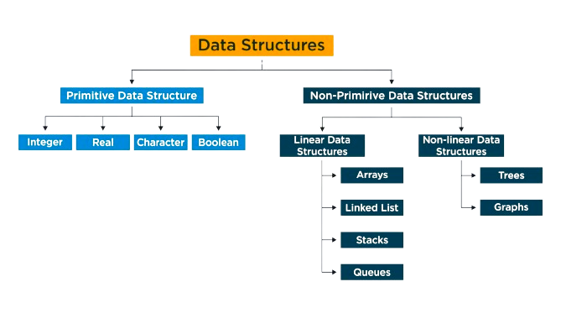
1. Introduction to Data Structure
1.1. types of data structures
1.2. Importance of Data Structure
2. Collection framework in Java
2.1.Introduction
2.2. Collection framework
2.3. Framework
2.4. Need for a Separate Collection Framework
2.5. All Collection Framework contain
2.5.1. Interfaces
2.5.2. Implementation
2.5.3. Algorithm
2.6. Java Collection Framework Hierarchy
2.7. Methods of Collection interface
3. Iterator Interface
4. Iterable Interface
5. Collection Interface
5.1. List Interface
5.2. ArrayList
5.2.1. ArrayList methods
5.3. LinkedList
5.3..1. LinkedList methods
5.4. ArrayList Vs LinkedList
5.6. Stack
6. Queue Interface
6.1. Prioprity Queue
6.2. Deque Interface
6.3. ArrayDeque
7. Set Interface
7.1. HashSet
7.2. LinkedHashSet
7.3. SortedSet Interface
7.4. TreeSet
8. Java Map Interface
8.1. HashMap
8.1.1 Hashmap declaration in Java
8.1.2 Java Hashmap Example
8.2. Linked HashMap Interface
8.2.1. Linked HashMap declaration in Java
8.2.2. Java Linked HashMap Example
8.3. Java TreeMap Class
8.3.1. TreeMap declaration in Java
9. Collection Sort in Java
10. Binary Search in Java
10.1. Implementation of Binary Search
11. Stack
11.1 Stack Class Java
11.2 Initialization of stack in Java
11.3 Methods of Stack class
12 CRUD operation in ArrayList
12.1. Adding to an ArrayList
12.2. Updating in an ArrayList
12.3. Deleting from an ArrayList
13. Data Access Object(DAO) Pattern
13.1. Implementation of DAO
Types of data structures

Slide 7
1. Introduction to Data Structure
1.1. types of data structures
1.2. Importance of Data Structure
2. Collection framework in Java
2.1.Introduction
2.2. Collection framework
2.3. Framework
2.4. Need for a Separate Collection Framework
2.5. All Collection Framework contain
2.5.1. Interfaces
2.5.2. Implementation
2.5.3. Algorithm
2.6. Java Collection Framework Hierarchy
2.7. Methods of Collection interface
3. Iterator Interface
4. Iterable Interface
5. Collection Interface
5.1. List Interface
5.2. ArrayList
5.2.1. ArrayList methods
5.3. LinkedList
5.3..1. LinkedList methods
5.4. ArrayList Vs LinkedList
5.6. Stack
6. Queue Interface
6.1. Prioprity Queue
6.2. Deque Interface
6.3. ArrayDeque
7. Set Interface
7.1. HashSet
7.2. LinkedHashSet
7.3. SortedSet Interface
7.4. TreeSet
8. Java Map Interface
8.1. HashMap
8.1.1 Hashmap declaration in Java
8.1.2 Java Hashmap Example
8.2. Linked HashMap Interface
8.2.1. Linked HashMap declaration in Java
8.2.2. Java Linked HashMap Example
8.3. Java TreeMap Class
8.3.1. TreeMap declaration in Java
9. Collection Sort in Java
10. Binary Search in Java
10.1. Implementation of Binary Search
11. Stack
11.1 Stack Class Java
11.2 Initialization of stack in Java
11.3 Methods of Stack class
12 CRUD operation in ArrayList
12.1. Adding to an ArrayList
12.2. Updating in an ArrayList
12.3. Deleting from an ArrayList
13. Data Access Object(DAO) Pattern
13.1. Implementation of DAO
Importance of Data Structure
Efficient storage and retrieval of data
Data structures allow you to store and retrieve data in an efficient manner.
Improved performance
Data structures can help improve the performance of your code by reducing the time and space complexity of algorithms.
Better problem solving
Data structures can help you solve complex problems by breaking them down into smaller, more manageable parts.

Slide 8
1. Introduction to Data Structure
1.1. types of data structures
1.2. Importance of Data Structure
2. Collection framework in Java
2.1.Introduction
2.2. Collection framework
2.3. Framework
2.4. Need for a Separate Collection Framework
2.5. All Collection Framework contain
2.5.1. Interfaces
2.5.2. Implementation
2.5.3. Algorithm
2.6. Java Collection Framework Hierarchy
2.7. Methods of Collection interface
3. Iterator Interface
4. Iterable Interface
5. Collection Interface
5.1. List Interface
5.2. ArrayList
5.2.1. ArrayList methods
5.3. LinkedList
5.3..1. LinkedList methods
5.4. ArrayList Vs LinkedList
5.6. Stack
6. Queue Interface
6.1. Prioprity Queue
6.2. Deque Interface
6.3. ArrayDeque
7. Set Interface
7.1. HashSet
7.2. LinkedHashSet
7.3. SortedSet Interface
7.4. TreeSet
8. Java Map Interface
8.1. HashMap
8.1.1 Hashmap declaration in Java
8.1.2 Java Hashmap Example
8.2. Linked HashMap Interface
8.2.1. Linked HashMap declaration in Java
8.2.2. Java Linked HashMap Example
8.3. Java TreeMap Class
8.3.1. TreeMap declaration in Java
9. Collection Sort in Java
10. Binary Search in Java
10.1. Implementation of Binary Search
11. Stack
11.1 Stack Class Java
11.2 Initialization of stack in Java
11.3 Methods of Stack class
12 CRUD operation in ArrayList
12.1. Adding to an ArrayList
12.2. Updating in an ArrayList
12.3. Deleting from an ArrayList
13. Data Access Object(DAO) Pattern
13.1. Implementation of DAO
Importance of Data Structure
Abstraction
Data structures provide a way to abstract the underlying complexity of a problem and simplify it, making it easier to understand and solve.

Slide 9
Collection framework in Java
1. Introduction to Data Structure
1.1. types of data structures
1.2. Importance of Data Structure
2. Collection framework in Java
2.1.Introduction
2.2. Collection framework
2.3. Framework
2.4. Need for a Separate Collection Framework
2.5. All Collection Framework contain
2.5.1. Interfaces
2.5.2. Implementation
2.5.3. Algorithm
2.6. Java Collection Framework Hierarchy
2.7. Methods of Collection interface
3. Iterator Interface
4. Iterable Interface
5. Collection Interface
5.1. List Interface
5.2. ArrayList
5.2.1. ArrayList methods
5.3. LinkedList
5.3.1. LinkedList methods
5.4. ArrayList Vs LinkedList
5.6. Stack
6. Queue Interface
6.1. Priority Queue
6.2. Deque Interface
6.3. ArrayDeque
7. Set Interface
7.1. HashSet
7.2. LinkedHashSet
7.3. SortedSet Interface
7.4. TreeSet
8. Java Map Interface
8.1. HashMap
8.1.1 Hashmap declaration in Java
8.1.2 Java Hashmap Example
8.2. Linked HashMap Interface
8.2.1. Linked HashMap declaration in Java
8.2.2. Java Linked HashMap Example
8.3. Java TreeMap Class
8.3.1. TreeMap declaration in Java
9. Collection Sort in Java
10. Binary Search in Java
10.1. Implementation of Binary Search
11. Stack
11.1 Stack Class Java
11.2 Initialization of stack in Java
11.3 Methods of Stack class
12 CRUD operation in ArrayList
12.1. Adding to an ArrayList
12.2. Updating in an ArrayList
12.3. Deleting from an ArrayList
13. Data Access Object(DAO) Pattern
13.1. Implementation of DAO

Slide 10
1. Introduction to Data Structure
1.1. types of data structures
1.2. Importance of Data Structure
2. Collection framework in Java
2.1.Introduction
2.2. Collection framework
2.3. Framework
2.4. Need for a Separate Collection Framework
2.5. All Collection Framework contain
2.5.1. Interfaces
2.5.2. Implementation
2.5.3. Algorithm
2.6. Java Collection Framework Hierarchy
2.7. Methods of Collection interface
3. Iterator Interface
4. Iterable Interface
5. Collection Interface
5.1. List Interface
5.2. ArrayList
5.2.1. ArrayList methods
5.3. LinkedList
5.3.1. LinkedList methods
5.4. ArrayList Vs LinkedList
5.6. Stack
6. Queue Interface
6.1. Priority Queue
6.2. Deque Interface
6.3. ArrayDeque
7. Set Interface
7.1. HashSet
7.2. LinkedHashSet
7.3. SortedSet Interface
7.4. TreeSet
8. Java Map Interface
8.1. HashMap
8.1.1 Hashmap declaration in Java
8.1.2 Java Hashmap Example
8.2. Linked HashMap Interface
8.2.1. Linked HashMap declaration in Java
8.2.2. Java Linked HashMap Example
8.3. Java TreeMap Class
8.3.1. TreeMap declaration in Java
9. Collection Sort in Java
10. Binary Search in Java
10.1. Implementation of Binary Search
11. Stack
11.1 Stack Class Java
11.2 Initialization of stack in Java
11.3 Methods of Stack class
12 CRUD operation in ArrayList
12.1. Adding to an ArrayList
12.2. Updating in an ArrayList
12.3. Deleting from an ArrayList
13. Data Access Object(DAO) Pattern
13.1. Implementation of DAO
Introduction
Any group of individual objects which are represented as a single unit is known as the collection of the objects.
In Java, a separate framework named the ‘Collection framework’ has been defined in JDK 1.2 which holds all the collection Classes and interfaces in it.
The Java collections framework provides a set of interfaces and classes to implement various data structures and algorithms.

Slide 11
1. Introduction to Data Structure
1.1. types of data structures
1.2. Importance of Data Structure
2. Collection framework in Java
2.1.Introduction
2.2. Collection framework
2.3. Framework
2.4. Need for a Separate Collection Framework
2.5. All Collection Framework contain
2.5.1. Interfaces
2.5.2. Implementation
2.5.3. Algorithm
2.6. Java Collection Framework Hierarchy
2.7. Methods of Collection interface
3. Iterator Interface
4. Iterable Interface
5. Collection Interface
5.1. List Interface
5.2. ArrayList
5.2.1. ArrayList methods
5.3. LinkedList
5.3.1. LinkedList methods
5.4. ArrayList Vs LinkedList
5.6. Stack
6. Queue Interface
6.1. Priority Queue
6.2. Deque Interface
6.3. ArrayDeque
7. Set Interface
7.1. HashSet
7.2. LinkedHashSet
7.3. SortedSet Interface
7.4. TreeSet
8. Java Map Interface
8.1. HashMap
8.1.1 Hashmap declaration in Java
8.1.2 Java Hashmap Example
8.2. Linked HashMap Interface
8.2.1. Linked HashMap declaration in Java
8.2.2. Java Linked HashMap Example
8.3. Java TreeMap Class
8.3.1. TreeMap declaration in Java
9. Collection Sort in Java
10. Binary Search in Java
10.1. Implementation of Binary Search
11. Stack
11.1 Stack Class Java
11.2 Initialization of stack in Java
11.3 Methods of Stack class
12 CRUD operation in ArrayList
12.1. Adding to an ArrayList
12.2. Updating in an ArrayList
12.3. Deleting from an ArrayList
13. Data Access Object(DAO) Pattern
13.1. Implementation of DAO
Collection framework
Java Collections can achieve all the operations that you perform on a data such as searching, sorting, insertion, manipulation, and deletion.
Java Collection means a single unit of objects. Java Collection framework provides many interfaces (Set, List, Queue, Deque) and classes (ArrayList, Vector, LinkedList, PriorityQueue, HashSet, LinkedHashSet, TreeSet).

Slide 12
1. Introduction to Data Structure
1.1. types of data structures
1.2. Importance of Data Structure
2. Collection framework in Java
2.1.Introduction
2.2. Collection framework
2.3. Framework
2.4. Need for a Separate Collection Framework
2.5. All Collection Framework contain
2.5.1. Interfaces
2.5.2. Implementation
2.5.3. Algorithm
2.6. Java Collection Framework Hierarchy
2.7. Methods of Collection interface
3. Iterator Interface
4. Iterable Interface
5. Collection Interface
5.1. List Interface
5.2. ArrayList
5.2.1. ArrayList methods
5.3. LinkedList
5.3.1. LinkedList methods
5.4. ArrayList Vs LinkedList
5.6. Stack
6. Queue Interface
6.1. Priority Queue
6.2. Deque Interface
6.3. ArrayDeque
7. Set Interface
7.1. HashSet
7.2. LinkedHashSet
7.3. SortedSet Interface
7.4. TreeSet
8. Java Map Interface
8.1. HashMap
8.1.1 Hashmap declaration in Java
8.1.2 Java Hashmap Example
8.2. Linked HashMap Interface
8.2.1. Linked HashMap declaration in Java
8.2.2. Java Linked HashMap Example
8.3. Java TreeMap Class
8.3.1. TreeMap declaration in Java
9. Collection Sort in Java
10. Binary Search in Java
10.1. Implementation of Binary Search
11. Stack
11.1 Stack Class Java
11.2 Initialization of stack in Java
11.3 Methods of Stack class
12 CRUD operation in ArrayList
12.1. Adding to an ArrayList
12.2. Updating in an ArrayList
12.3. Deleting from an ArrayList
13. Data Access Object(DAO) Pattern
13.1. Implementation of DAO
Framework
A framework is a set of classes and interfaces which provide a ready-made architecture. In order to implement a new feature or a class, there is no need to define a framework. However, an optimal object-oriented design always includes a framework with a collection of classes such that all the classes perform the same kind of task. The use of framework is optional.

Slide 13
1. Introduction to Data Structure
1.1. types of data structures
1.2. Importance of Data Structure
2. Collection framework in Java
2.1.Introduction
2.2. Collection framework
2.3. Framework
2.4. Need for a Separate Collection Framework
2.5. All Collection Framework contain
2.5.1. Interfaces
2.5.2. Implementation
2.5.3. Algorithm
2.6. Java Collection Framework Hierarchy
2.7. Methods of Collection interface
3. Iterator Interface
4. Iterable Interface
5. Collection Interface
5.1. List Interface
5.2. ArrayList
5.2.1. ArrayList methods
5.3. LinkedList
5.3.1. LinkedList methods
5.4. ArrayList Vs LinkedList
5.6. Stack
6. Queue Interface
6.1. Priority Queue
6.2. Deque Interface
6.3. ArrayDeque
7. Set Interface
7.1. HashSet
7.2. LinkedHashSet
7.3. SortedSet Interface
7.4. TreeSet
8. Java Map Interface
8.1. HashMap
8.1.1 Hashmap declaration in Java
8.1.2 Java Hashmap Example
8.2. Linked HashMap Interface
8.2.1. Linked HashMap declaration in Java
8.2.2. Java Linked HashMap Example
8.3. Java TreeMap Class
8.3.1. TreeMap declaration in Java
9. Collection Sort in Java
10. Binary Search in Java
10.1. Implementation of Binary Search
11. Stack
11.1 Stack Class Java
11.2 Initialization of stack in Java
11.3 Methods of Stack class
12 CRUD operation in ArrayList
12.1. Adding to an ArrayList
12.2. Updating in an ArrayList
12.3. Deleting from an ArrayList
13. Data Access Object(DAO) Pattern
13.1. Implementation of DAO
Need for a Separate Collection
Framework
Before the Collection Framework(or before JDK 1.2) was introduced, the standard methods for grouping Java objects (or collections) were Arrays or Vectors, or Hashtables.
All of these collections had no common interface.Therefore, though the main aim of all the collections is the same, the implementation of all these collections was defined independently and had no correlation among them.
Also, it is very difficult for the users to remember all the different
methods, syntax, and constructors present in every collection class.

Slide 14
1. Introduction to Data Structure
1.1. types of data structures
1.2. Importance of Data Structure
2. Collection framework in Java
2.1.Introduction
2.2. Collection framework
2.3. Framework
2.4. Need for a Separate Collection Framework
2.5. All Collection Framework contain
2.5.1. Interfaces
2.5.2. Implementation
2.5.3. Algorithm
2.6. Java Collection Framework Hierarchy
2.7. Methods of Collection interface
3. Iterator Interface
4. Iterable Interface
5. Collection Interface
5.1. List Interface
5.2. ArrayList
5.2.1. ArrayList methods
5.3. LinkedList
5.3.1. LinkedList methods
5.4. ArrayList Vs LinkedList
5.6. Stack
6. Queue Interface
6.1. Priority Queue
6.2. Deque Interface
6.3. ArrayDeque
7. Set Interface
7.1. HashSet
7.2. LinkedHashSet
7.3. SortedSet Interface
7.4. TreeSet
8. Java Map Interface
8.1. HashMap
8.1.1 Hashmap declaration in Java
8.1.2 Java Hashmap Example
8.2. Linked HashMap Interface
8.2.1. Linked HashMap declaration in Java
8.2.2. Java Linked HashMap Example
8.3. Java TreeMap Class
8.3.1. TreeMap declaration in Java
9. Collection Sort in Java
10. Binary Search in Java
10.1. Implementation of Binary Search
11. Stack
11.1 Stack Class Java
11.2 Initialization of stack in Java
11.3 Methods of Stack class
12 CRUD operation in ArrayList
12.1. Adding to an ArrayList
12.2. Updating in an ArrayList
12.3. Deleting from an ArrayList
13. Data Access Object(DAO) Pattern
13.1. Implementation of DAO
Need for a Separate Collection
Framework
The framework had to be high-performance. The implementations for the fundamental collections (dynamic arrays, linked lists, trees, and hashtables) were to be highly efficient.
The framework had to allow different types of collections to work in a similar manner and with a high degree of interoperability.
The framework had to extend and/or adapt a collection easily.

Slide 15
1. Introduction to Data Structure
1.1. types of data structures
1.2. Importance of Data Structure
2. Collection framework in Java
2.1.Introduction
2.2. Collection framework
2.3. Framework
2.4. Need for a Separate Collection Framework
2.5. All Collection Framework contain
2.5.1. Interfaces
2.5.2. Implementation
2.5.3. Algorithm
2.6. Java Collection Framework Hierarchy
2.7. Methods of Collection interface
3. Iterator Interface
4. Iterable Interface
5. Collection Interface
5.1. List Interface
5.2. ArrayList
5.2.1. ArrayList methods
5.3. LinkedList
5.3.1. LinkedList methods
5.4. ArrayList Vs LinkedList
5.6. Stack
6. Queue Interface
6.1. Priority Queue
6.2. Deque Interface
6.3. ArrayDeque
7. Set Interface
7.1. HashSet
7.2. LinkedHashSet
7.3. SortedSet Interface
7.4. TreeSet
8. Java Map Interface
8.1. HashMap
8.1.1 Hashmap declaration in Java
8.1.2 Java Hashmap Example
8.2. Linked HashMap Interface
8.2.1. Linked HashMap declaration in Java
8.2.2. Java Linked HashMap Example
8.3. Java TreeMap Class
8.3.1. TreeMap declaration in Java
9. Collection Sort in Java
10. Binary Search in Java
10.1. Implementation of Binary Search
11. Stack
11.1 Stack Class Java
11.2 Initialization of stack in Java
11.3 Methods of Stack class
12 CRUD operation in ArrayList
12.1. Adding to an ArrayList
12.2. Updating in an ArrayList
12.3. Deleting from an ArrayList
13. Data Access Object(DAO) Pattern
13.1. Implementation of DAO
Collection Framework
“A unified architecture for representing and manipulating collections, enabling collections to be manipulated independently of implementation details”
The Java collections framework provides a set of interfaces and classes to implement various data structures and algorithms.
For example, the LinkedList class of the collections framework provides the implementation of the doubly-linked list data structure.

Slide 16
1. Introduction to Data Structure
1.1. types of data structures
1.2. Importance of Data Structure
2. Collection framework in Java
2.1.Introduction
2.2. Collection framework
2.3. Framework
2.4. Need for a Separate Collection Framework
2.5. All Collection Framework contain
2.5.1. Interfaces
2.5.2. Implementation
2.5.3. Algorithm
2.6. Java Collection Framework Hierarchy
2.7. Methods of Collection interface
3. Iterator Interface
4. Iterable Interface
5. Collection Interface
5.1. List Interface
5.2. ArrayList
5.2.1. ArrayList methods
5.3. LinkedList
5.3.1. LinkedList methods
5.4. ArrayList Vs LinkedList
5.6. Stack
6. Queue Interface
6.1. Priority Queue
6.2. Deque Interface
6.3. ArrayDeque
7. Set Interface
7.1. HashSet
7.2. LinkedHashSet
7.3. SortedSet Interface
7.4. TreeSet
8. Java Map Interface
8.1. HashMap
8.1.1 Hashmap declaration in Java
8.1.2 Java Hashmap Example
8.2. Linked HashMap Interface
8.2.1. Linked HashMap declaration in Java
8.2.2. Java Linked HashMap Example
8.3. Java TreeMap Class
8.3.1. TreeMap declaration in Java
9. Collection Sort in Java
10. Binary Search in Java
10.1. Implementation of Binary Search
11. Stack
11.1 Stack Class Java
11.2 Initialization of stack in Java
11.3 Methods of Stack class
12 CRUD operation in ArrayList
12.1. Adding to an ArrayList
12.2. Updating in an ArrayList
12.3. Deleting from an ArrayList
13. Data Access Object(DAO) Pattern
13.1. Implementation of DAO
All collections frameworks contain the
following:
interfaces
implementation(i.e. classes)
algorithms
Interfaces
These are abstract data types that represent collections. Interfaces allow collections to be manipulated independently of the details of their representation. In object-oriented languages, interfaces generally form a hierarchy.

Slide 17
1. Introduction to Data Structure
1.1. types of data structures
1.2. Importance of Data Structure
2. Collection framework in Java
2.1.Introduction
2.2. Collection framework
2.3. Framework
2.4. Need for a Separate Collection Framework
2.5. All Collection Framework contain
2.5.1. Interfaces
2.5.2. Implementation
2.5.3. Algorithm
2.6. Java Collection Framework Hierarchy
2.7. Methods of Collection interface
3. Iterator Interface
4. Iterable Interface
5. Collection Interface
5.1. List Interface
5.2. ArrayList
5.2.1. ArrayList methods
5.3. LinkedList
5.3.1. LinkedList methods
5.4. ArrayList Vs LinkedList
5.6. Stack
6. Queue Interface
6.1. Priority Queue
6.2. Deque Interface
6.3. ArrayDeque
7. Set Interface
7.1. HashSet
7.2. LinkedHashSet
7.3. SortedSet Interface
7.4. TreeSet
8. Java Map Interface
8.1. HashMap
8.1.1 Hashmap declaration in Java
8.1.2 Java Hashmap Example
8.2. Linked HashMap Interface
8.2.1. Linked HashMap declaration in Java
8.2.2. Java Linked HashMap Example
8.3. Java TreeMap Class
8.3.1. TreeMap declaration in Java
9. Collection Sort in Java
10. Binary Search in Java
10.1. Implementation of Binary Search
11. Stack
11.1 Stack Class Java
11.2 Initialization of stack in Java
11.3 Methods of Stack class
12 CRUD operation in ArrayList
12.1. Adding to an ArrayList
12.2. Updating in an ArrayList
12.3. Deleting from an ArrayList
13. Data Access Object(DAO) Pattern
13.1. Implementation of DAO
2. Implementation (i.e. classes)
These are the concrete implementations of the collection interfaces. In essence, they are reusable data structures.
3. Algorithm
These are the methods that perform useful computations, such as searching and sorting, on objects that implement collection interfaces. The algorithms are said to be polymorphic: that is, the same method can be used on many different implementations of the appropriate collection interface.

Slide 18
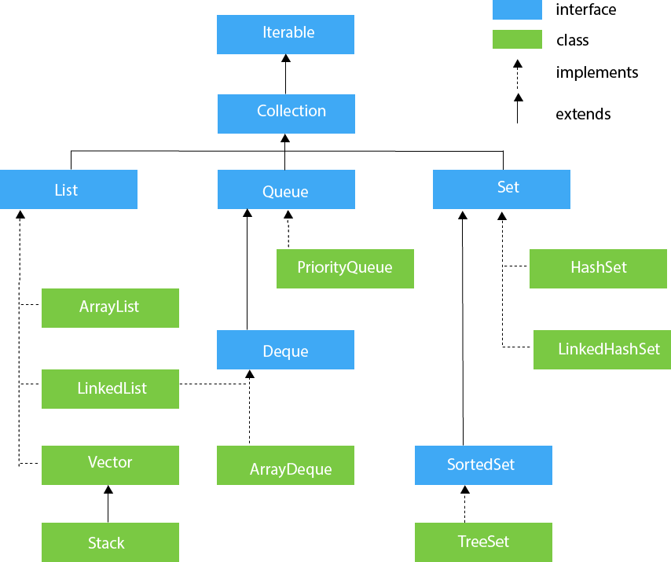
1. Introduction to Data Structure
1.1. types of data structures
1.2. Importance of Data Structure
2. Collection framework in Java
2.1.Introduction
2.2. Collection framework
2.3. Framework
2.4. Need for a Separate Collection Framework
2.5. All Collection Framework contain
2.5.1. Interfaces
2.5.2. Implementation
2.5.3. Algorithm
2.6. Java Collection Framework Hierarchy
2.7. Methods of Collection interface
3. Iterator Interface
4. Iterable Interface
5. Collection Interface
5.1. List Interface
5.2. ArrayList
5.2.1. ArrayList methods
5.3. LinkedList
5.3.1. LinkedList methods
5.4. ArrayList Vs LinkedList
5.6. Stack
6. Queue Interface
6.1. Priority Queue
6.2. Deque Interface
6.3. ArrayDeque
7. Set Interface
7.1. HashSet
7.2. LinkedHashSet
7.3. SortedSet Interface
7.4. TreeSet
8. Java Map Interface
8.1. HashMap
8.1.1 Hashmap declaration in Java
8.1.2 Java Hashmap Example
8.2. Linked HashMap Interface
8.2.1. Linked HashMap declaration in Java
8.2.2. Java Linked HashMap Example
8.3. Java TreeMap Class
8.3.1. TreeMap declaration in Java
9. Collection Sort in Java
10. Binary Search in Java
10.1. Implementation of Binary Search
11. Stack
11.1 Stack Class Java
11.2 Initialization of stack in Java
11.3 Methods of Stack class
12 CRUD operation in ArrayList
12.1. Adding to an ArrayList
12.2. Updating in an ArrayList
12.3. Deleting from an ArrayList
13. Data Access Object(DAO) Pattern
13.1. Implementation of DAO
Java Collection Framework Hierarchy

Slide 19
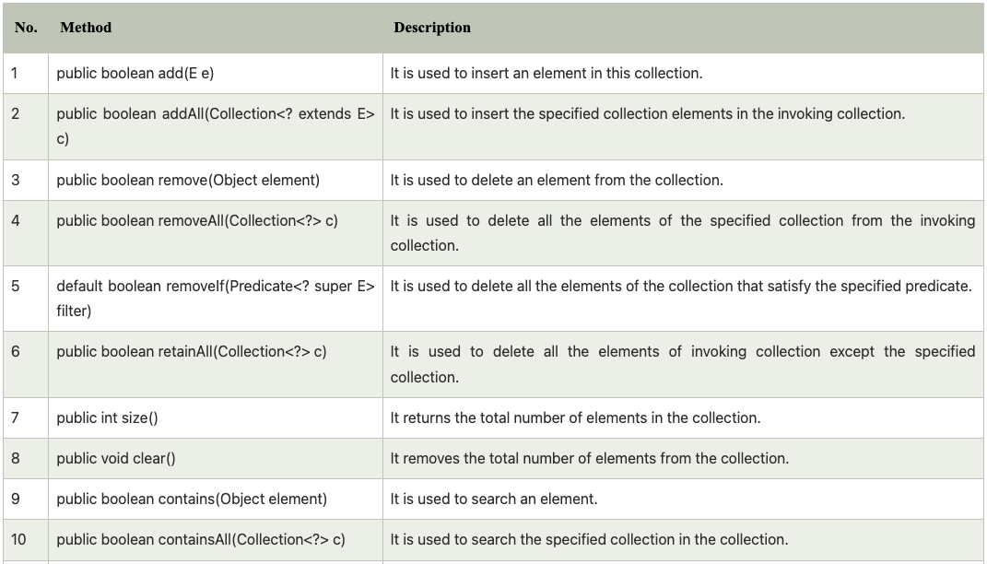
1. Introduction to Data Structure
1.1. types of data structures
1.2. Importance of Data Structure
2. Collection framework in Java
2.1.Introduction
2.2. Collection framework
2.3. Framework
2.4. Need for a Separate Collection Framework
2.5. All Collection Framework contain
2.5.1. Interfaces
2.5.2. Implementation
2.5.3. Algorithm
2.6. Java Collection Framework Hierarchy
2.7. Methods of Collection interface
3. Iterator Interface
4. Iterable Interface
5. Collection Interface
5.1. List Interface
5.2. ArrayList
5.2.1. ArrayList methods
5.3. LinkedList
5.3.1. LinkedList methods
5.4. ArrayList Vs LinkedList
5.6. Stack
6. Queue Interface
6.1. Priority Queue
6.2. Deque Interface
6.3. ArrayDeque
7. Set Interface
7.1. HashSet
7.2. LinkedHashSet
7.3. SortedSet Interface
7.4. TreeSet
8. Java Map Interface
8.1. HashMap
8.1.1 Hashmap declaration in Java
8.1.2 Java Hashmap Example
8.2. Linked HashMap Interface
8.2.1. Linked HashMap declaration in Java
8.2.2. Java Linked HashMap Example
8.3. Java TreeMap Class
8.3.1. TreeMap declaration in Java
9. Collection Sort in Java
10. Binary Search in Java
10.1. Implementation of Binary Search
11. Stack
11.1 Stack Class Java
11.2 Initialization of stack in Java
11.3 Methods of Stack class
12 CRUD operation in ArrayList
12.1. Adding to an ArrayList
12.2. Updating in an ArrayList
12.3. Deleting from an ArrayList
13. Data Access Object(DAO) Pattern
13.1. Implementation of DAO
Methods of Collection interface

Slide 20
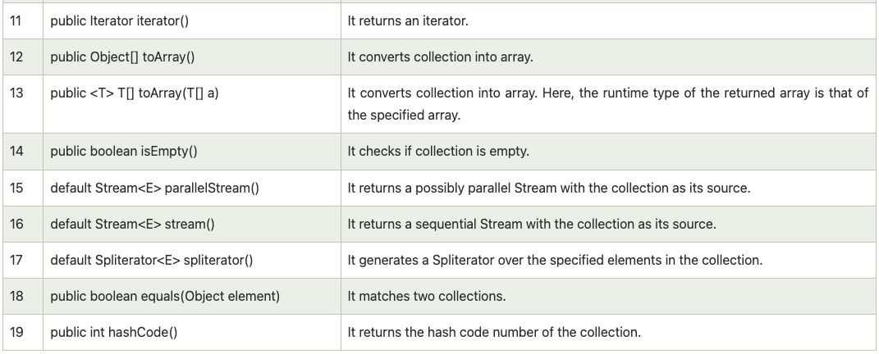
1. Introduction to Data Structure
1.1. types of data structures
1.2. Importance of Data Structure
2. Collection framework in Java
2.1.Introduction
2.2. Collection framework
2.3. Framework
2.4. Need for a Separate Collection Framework
2.5. All Collection Framework contain
2.5.1. Interfaces
2.5.2. Implementation
2.5.3. Algorithm
2.6. Java Collection Framework Hierarchy
2.7. Methods of Collection interface
3. Iterator Interface
4. Iterable Interface
5. Collection Interface
5.1. List Interface
5.2. ArrayList
5.2.1. ArrayList methods
5.3. LinkedList
5.3.1. LinkedList methods
5.4. ArrayList Vs LinkedList
5.6. Stack
6. Queue Interface
6.1. Priority Queue
6.2. Deque Interface
6.3. ArrayDeque
7. Set Interface
7.1. HashSet
7.2. LinkedHashSet
7.3. SortedSet Interface
7.4. TreeSet
8. Java Map Interface
8.1. HashMap
8.1.1 Hashmap declaration in Java
8.1.2 Java Hashmap Example
8.2. Linked HashMap Interface
8.2.1. Linked HashMap declaration in Java
8.2.2. Java Linked HashMap Example
8.3. Java TreeMap Class
8.3.1. TreeMap declaration in Java
9. Collection Sort in Java
10. Binary Search in Java
10.1. Implementation of Binary Search
11. Stack
11.1 Stack Class Java
11.2 Initialization of stack in Java
11.3 Methods of Stack class
12 CRUD operation in ArrayList
12.1. Adding to an ArrayList
12.2. Updating in an ArrayList
12.3. Deleting from an ArrayList
13. Data Access Object(DAO) Pattern
13.1. Implementation of DAO
Methods of Collection interface

Slide 21
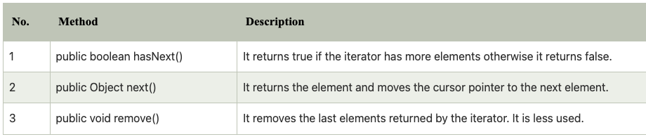
1. Introduction to Data Structure
1.1. types of data structures
1.2. Importance of Data Structure
2. Collection framework in Java
2.1.Introduction
2.2. Collection framework
2.3. Framework
2.4. Need for a Separate Collection Framework
2.5. All Collection Framework contain
2.5.1. Interfaces
2.5.2. Implementation
2.5.3. Algorithm
2.6. Java Collection Framework Hierarchy
2.7. Methods of Collection interface
3. Iterator Interface
4. Iterable Interface
5. Collection Interface
5.1. List Interface
5.2. ArrayList
5.2.1. ArrayList methods
5.3. LinkedList
5.3.1. LinkedList methods
5.4. ArrayList Vs LinkedList
5.6. Stack
6. Queue Interface
6.1. Priority Queue
6.2. Deque Interface
6.3. ArrayDeque
7. Set Interface
7.1. HashSet
7.2. LinkedHashSet
7.3. SortedSet Interface
7.4. TreeSet
8. Java Map Interface
8.1. HashMap
8.1.1 Hashmap declaration in Java
8.1.2 Java Hashmap Example
8.2. Linked HashMap Interface
8.2.1. Linked HashMap declaration in Java
8.2.2. Java Linked HashMap Example
8.3. Java TreeMap Class
8.3.1. TreeMap declaration in Java
9. Collection Sort in Java
10. Binary Search in Java
10.1. Implementation of Binary Search
11. Stack
11.1 Stack Class Java
11.2 Initialization of stack in Java
11.3 Methods of Stack class
12 CRUD operation in ArrayList
12.1. Adding to an ArrayList
12.2. Updating in an ArrayList
12.3. Deleting from an ArrayList
13. Data Access Object(DAO) Pattern
13.1. Implementation of DAO
Iterator Interface
Iterator interface provides the facility of iterating the elements in a forward direction only.
Methods of Iterator interface
There are only three methods in the Iterator interface. They are:

Slide 22

1. Introduction to Data Structure
1.1. types of data structures
1.2. Importance of Data Structure
2. Collection framework in Java
2.1.Introduction
2.2. Collection framework
2.3. Framework
2.4. Need for a Separate Collection Framework
2.5. All Collection Framework contain
2.5.1. Interfaces
2.5.2. Implementation
2.5.3. Algorithm
2.6. Java Collection Framework Hierarchy
2.7. Methods of Collection interface
3. Iterator Interface
4. Iterable Interface
5. Collection Interface
5.1. List Interface
5.2. ArrayList
5.2.1. ArrayList methods
5.3. LinkedList
5.3.1. LinkedList methods
5.4. ArrayList Vs LinkedList
5.6. Stack
6. Queue Interface
6.1. Priority Queue
6.2. Deque Interface
6.3. ArrayDeque
7. Set Interface
7.1. HashSet
7.2. LinkedHashSet
7.3. SortedSet Interface
7.4. TreeSet
8. Java Map Interface
8.1. HashMap
8.1.1 Hashmap declaration in Java
8.1.2 Java Hashmap Example
8.2. Linked HashMap Interface
8.2.1. Linked HashMap declaration in Java
8.2.2. Java Linked HashMap Example
8.3. Java TreeMap Class
8.3.1. TreeMap declaration in Java
9. Collection Sort in Java
10. Binary Search in Java
10.1. Implementation of Binary Search
11. Stack
11.1 Stack Class Java
11.2 Initialization of stack in Java
11.3 Methods of Stack class
12 CRUD operation in ArrayList
12.1. Adding to an ArrayList
12.2. Updating in an ArrayList
12.3. Deleting from an ArrayList
13. Data Access Object(DAO) Pattern
13.1. Implementation of DAO
Iterable Interface
The Iterable interface is the root interface for all the collection classes.
The Collection interface extends the Iterable interface and therefore all the subclasses of Collection interface also implement the Iterable interface.
It contains only one abstract method. i.e.,

Slide 23
1. Introduction to Data Structure
1.1. types of data structures
1.2. Importance of Data Structure
2. Collection framework in Java
2.1.Introduction
2.2. Collection framework
2.3. Framework
2.4. Need for a Separate Collection Framework
2.5. All Collection Framework contain
2.5.1. Interfaces
2.5.2. Implementation
2.5.3. Algorithm
2.6. Java Collection Framework Hierarchy
2.7. Methods of Collection interface
3. Iterator Interface
4. Iterable Interface
5. Collection Interface
5.1. List Interface
5.2. ArrayList
5.2.1. ArrayList methods
5.3. LinkedList
5.3.1. LinkedList methods
5.4. ArrayList Vs LinkedList
5.6. Stack
6. Queue Interface
6.1. Priority Queue
6.2. Deque Interface
6.3. ArrayDeque
7. Set Interface
7.1. HashSet
7.2. LinkedHashSet
7.3. SortedSet Interface
7.4. TreeSet
8. Java Map Interface
8.1. HashMap
8.1.1 Hashmap declaration in Java
8.1.2 Java Hashmap Example
8.2. Linked HashMap Interface
8.2.1. Linked HashMap declaration in Java
8.2.2. Java Linked HashMap Example
8.3. Java TreeMap Class
8.3.1. TreeMap declaration in Java
9. Collection Sort in Java
10. Binary Search in Java
10.1. Implementation of Binary Search
11. Stack
11.1 Stack Class Java
11.2 Initialization of stack in Java
11.3 Methods of Stack class
12 CRUD operation in ArrayList
12.1. Adding to an ArrayList
12.2. Updating in an ArrayList
12.3. Deleting from an ArrayList
13. Data Access Object(DAO) Pattern
13.1. Implementation of DAO
Collection Interface
The Collection interface is the interface which is implemented by all the classes in the collection framework.
It declares the methods that every collection will have. In other words, we can say that the Collection interface builds the foundation on which the collection framework depends.
Some of the methods of Collection interface are Boolean add ( Object obj), Boolean addAll ( Collection c), void clear(), etc. which are implemented by all the subclasses of Collection interface.

Slide 24
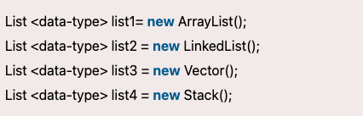
1. Introduction to Data Structure
1.1. types of data structures
1.2. Importance of Data Structure
2. Collection framework in Java
2.1.Introduction
2.2. Collection framework
2.3. Framework
2.4. Need for a Separate Collection Framework
2.5. All Collection Framework contain
2.5.1. Interfaces
2.5.2. Implementation
2.5.3. Algorithm
2.6. Java Collection Framework Hierarchy
2.7. Methods of Collection interface
3. Iterator Interface
4. Iterable Interface
5. Collection Interface
5.1. List Interface
5.2. ArrayList
5.2.1. ArrayList methods
5.3. LinkedList
5.3.1. LinkedList methods
5.4. ArrayList Vs LinkedList
5.6. Stack
6. Queue Interface
6.1. Priority Queue
6.2. Deque Interface
6.3. ArrayDeque
7. Set Interface
7.1. HashSet
7.2. LinkedHashSet
7.3. SortedSet Interface
7.4. TreeSet
8. Java Map Interface
8.1. HashMap
8.1.1 Hashmap declaration in Java
8.1.2 Java Hashmap Example
8.2. Linked HashMap Interface
8.2.1. Linked HashMap declaration in Java
8.2.2. Java Linked HashMap Example
8.3. Java TreeMap Class
8.3.1. TreeMap declaration in Java
9. Collection Sort in Java
10. Binary Search in Java
10.1. Implementation of Binary Search
11. Stack
11.1 Stack Class Java
11.2 Initialization of stack in Java
11.3 Methods of Stack class
12 CRUD operation in ArrayList
12.1. Adding to an ArrayList
12.2. Updating in an ArrayList
12.3. Deleting from an ArrayList
13. Data Access Object(DAO) Pattern
13.1. Implementation of DAO
List Interface
List interface is the child interface of Collection interface. It inhibits a list type data structure in which we can store the ordered collection of objects.
It can have duplicate values. List interface is implemented by the classes ArrayList, LinkedList, Vector, and Stack.
To instantiate the List interface, we must use :

Slide 25
1. Introduction to Data Structure
1.1. types of data structures
1.2. Importance of Data Structure
2. Collection framework in Java
2.1.Introduction
2.2. Collection framework
2.3. Framework
2.4. Need for a Separate Collection Framework
2.5. All Collection Framework contain
2.5.1. Interfaces
2.5.2. Implementation
2.5.3. Algorithm
2.6. Java Collection Framework Hierarchy
2.7. Methods of Collection interface
3. Iterator Interface
4. Iterable Interface
5. Collection Interface
5.1. List Interface
5.2. ArrayList
5.2.1. ArrayList methods
5.3. LinkedList
5.3.1. LinkedList methods
5.4. ArrayList Vs LinkedList
5.6. Stack
6. Queue Interface
6.1. Priority Queue
6.2. Deque Interface
6.3. ArrayDeque
7. Set Interface
7.1. HashSet
7.2. LinkedHashSet
7.3. SortedSet Interface
7.4. TreeSet
8. Java Map Interface
8.1. HashMap
8.1.1 Hashmap declaration in Java
8.1.2 Java Hashmap Example
8.2. Linked HashMap Interface
8.2.1. Linked HashMap declaration in Java
8.2.2. Java Linked HashMap Example
8.3. Java TreeMap Class
8.3.1. TreeMap declaration in Java
9. Collection Sort in Java
10. Binary Search in Java
10.1. Implementation of Binary Search
11. Stack
11.1 Stack Class Java
11.2 Initialization of stack in Java
11.3 Methods of Stack class
12 CRUD operation in ArrayList
12.1. Adding to an ArrayList
12.2. Updating in an ArrayList
12.3. Deleting from an ArrayList
13. Data Access Object(DAO) Pattern
13.1. Implementation of DAO
ArrayList
Java ArrayList class can contain duplicate elements.
Java ArrayList class maintains insertion order.
Java ArrayList class is non synchronized.
Java ArrayList allows random access because array works at the index basis.
In ArrayList, manipulation is little bit slower than the LinkedList in
Java because a lot of shifting needs to occur if any element is removed from the array list.

Slide 26
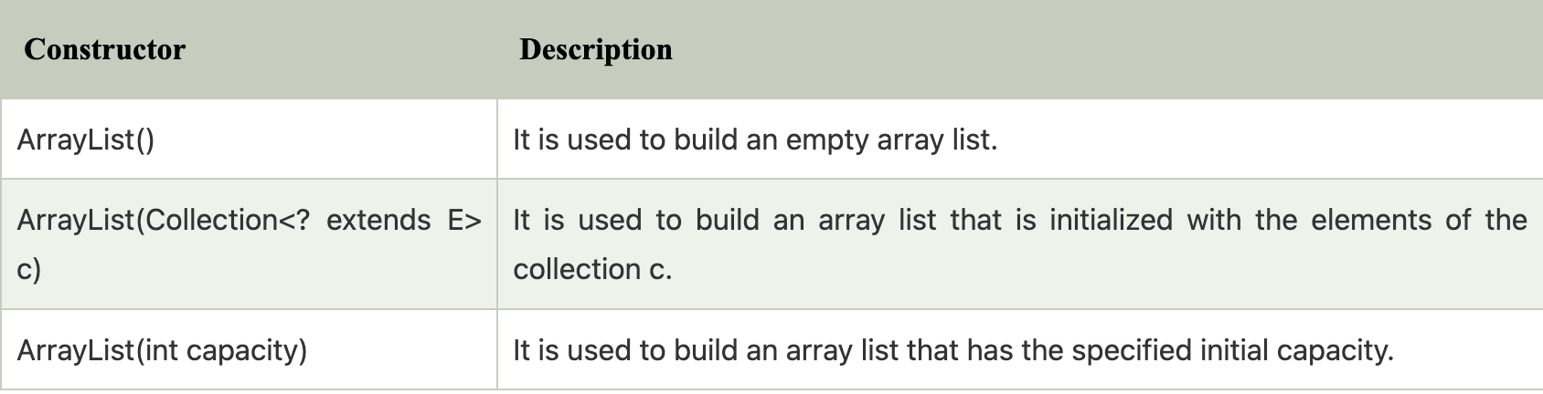
1. Introduction to Data Structure
1.1. types of data structures
1.2. Importance of Data Structure
2. Collection framework in Java
2.1.Introduction
2.2. Collection framework
2.3. Framework
2.4. Need for a Separate Collection Framework
2.5. All Collection Framework contain
2.5.1. Interfaces
2.5.2. Implementation
2.5.3. Algorithm
2.6. Java Collection Framework Hierarchy
2.7. Methods of Collection interface
3. Iterator Interface
4. Iterable Interface
5. Collection Interface
5.1. List Interface
5.2. ArrayList
5.2.1. ArrayList methods
5.3. LinkedList
5.3.1. LinkedList methods
5.4. ArrayList Vs LinkedList
5.6. Stack
6. Queue Interface
6.1. Priority Queue
6.2. Deque Interface
6.3. ArrayDeque
7. Set Interface
7.1. HashSet
7.2. LinkedHashSet
7.3. SortedSet Interface
7.4. TreeSet
8. Java Map Interface
8.1. HashMap
8.1.1 Hashmap declaration in Java
8.1.2 Java Hashmap Example
8.2. Linked HashMap Interface
8.2.1. Linked HashMap declaration in Java
8.2.2. Java Linked HashMap Example
8.3. Java TreeMap Class
8.3.1. TreeMap declaration in Java
9. Collection Sort in Java
10. Binary Search in Java
10.1. Implementation of Binary Search
11. Stack
11.1 Stack Class Java
11.2 Initialization of stack in Java
11.3 Methods of Stack class
12 CRUD operation in ArrayList
12.1. Adding to an ArrayList
12.2. Updating in an ArrayList
12.3. Deleting from an ArrayList
13. Data Access Object(DAO) Pattern
13.1. Implementation of DAO
ArrayList
Let's see the declaration for java.util.ArrayList class
Constructors of ArrayList

Slide 27
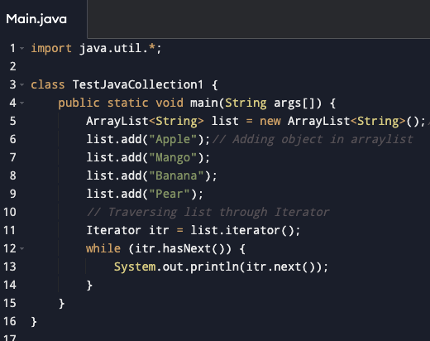
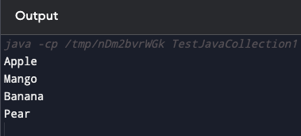
1. Introduction to Data Structure
1.1. types of data structures
1.2. Importance of Data Structure
2. Collection framework in Java
2.1.Introduction
2.2. Collection framework
2.3. Framework
2.4. Need for a Separate Collection Framework
2.5. All Collection Framework contain
2.5.1. Interfaces
2.5.2. Implementation
2.5.3. Algorithm
2.6. Java Collection Framework Hierarchy
2.7. Methods of Collection interface
3. Iterator Interface
4. Iterable Interface
5. Collection Interface
5.1. List Interface
5.2. ArrayList
5.2.1. ArrayList methods
5.3. LinkedList
5.3.1. LinkedList methods
5.4. ArrayList Vs LinkedList
5.6. Stack
6. Queue Interface
6.1. Priority Queue
6.2. Deque Interface
6.3. ArrayDeque
7. Set Interface
7.1. HashSet
7.2. LinkedHashSet
7.3. SortedSet Interface
7.4. TreeSet
8. Java Map Interface
8.1. HashMap
8.1.1 Hashmap declaration in Java
8.1.2 Java Hashmap Example
8.2. Linked HashMap Interface
8.2.1. Linked HashMap declaration in Java
8.2.2. Java Linked HashMap Example
8.3. Java TreeMap Class
8.3.1. TreeMap declaration in Java
9. Collection Sort in Java
10. Binary Search in Java
10.1. Implementation of Binary Search
11. Stack
11.1 Stack Class Java
11.2 Initialization of stack in Java
11.3 Methods of Stack class
12 CRUD operation in ArrayList
12.1. Adding to an ArrayList
12.2. Updating in an ArrayList
12.3. Deleting from an ArrayList
13. Data Access Object(DAO) Pattern
13.1. Implementation of DAO
ArrayList

Slide 28
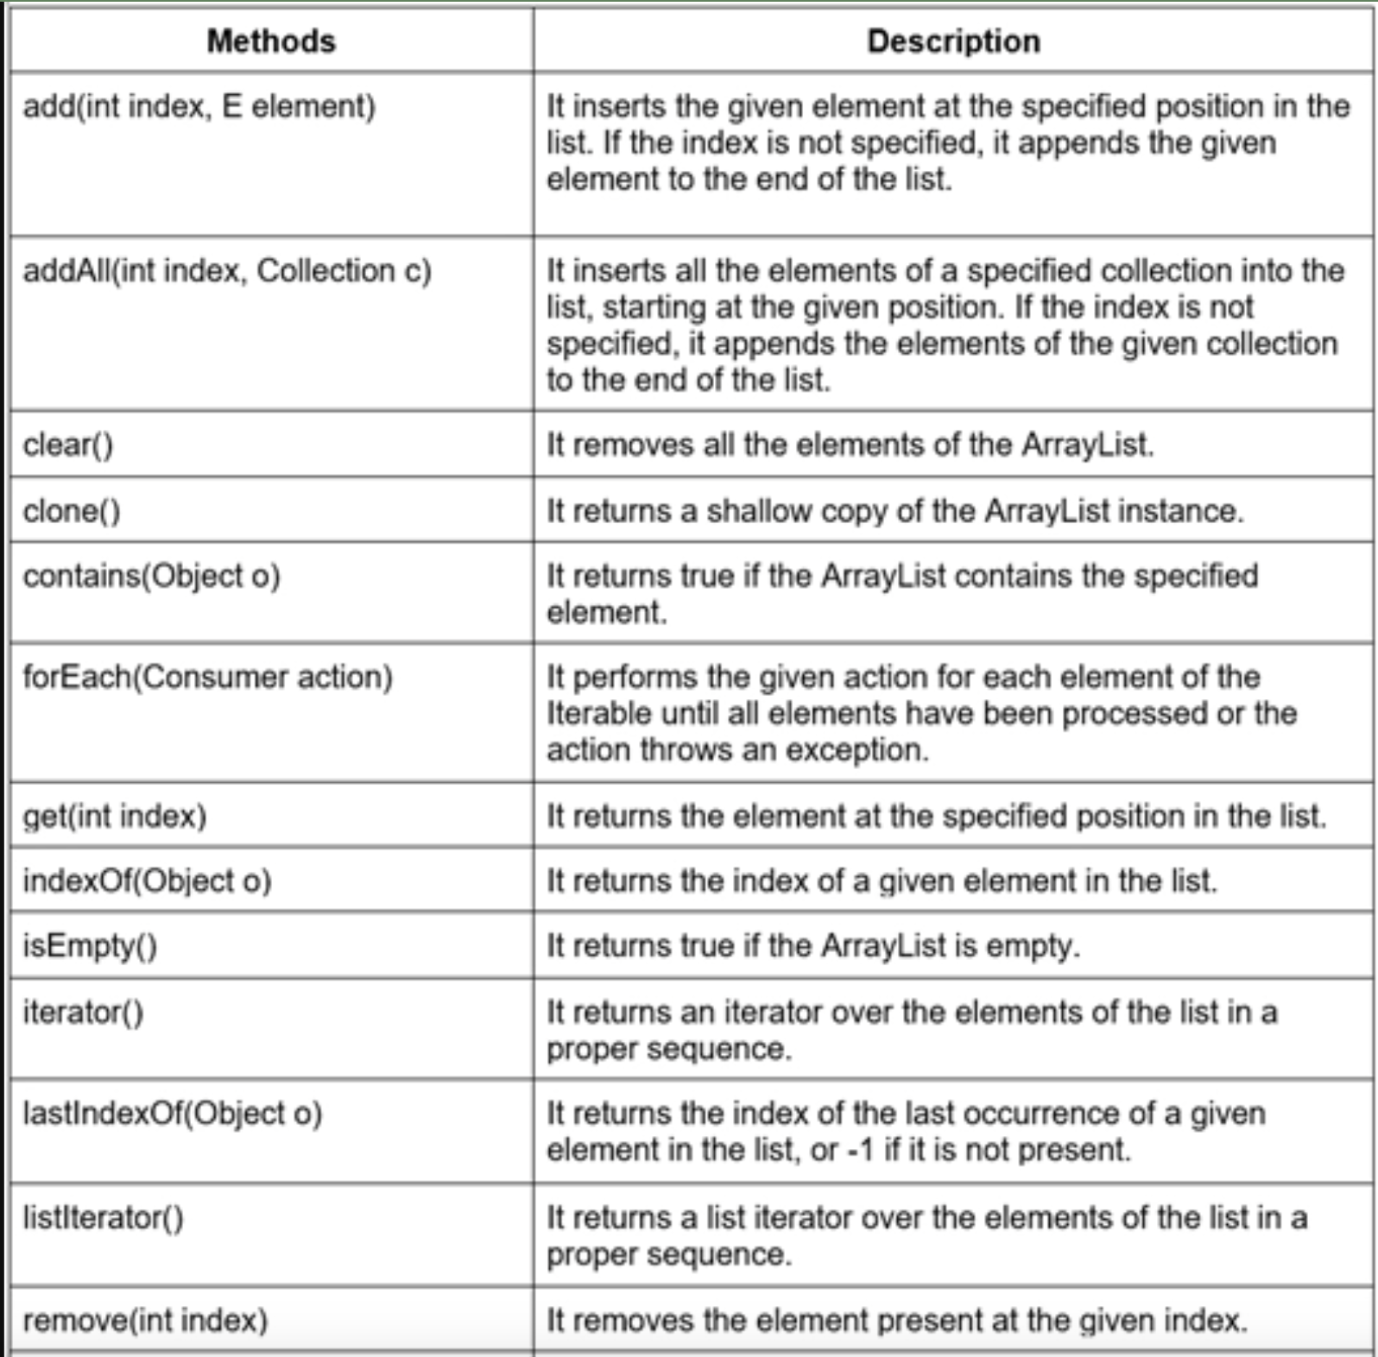
1. Introduction to Data Structure
1.1. types of data structures
1.2. Importance of Data Structure
2. Collection framework in Java
2.1.Introduction
2.2. Collection framework
2.3. Framework
2.4. Need for a Separate Collection Framework
2.5. All Collection Framework contain
2.5.1. Interfaces
2.5.2. Implementation
2.5.3. Algorithm
2.6. Java Collection Framework Hierarchy
2.7. Methods of Collection interface
3. Iterator Interface
4. Iterable Interface
5. Collection Interface
5.1. List Interface
5.2. ArrayList
5.2.1. ArrayList methods
5.3. LinkedList
5.3.1. LinkedList methods
5.4. ArrayList Vs LinkedList
5.6. Stack
6. Queue Interface
6.1. Priority Queue
6.2. Deque Interface
6.3. ArrayDeque
7. Set Interface
7.1. HashSet
7.2. LinkedHashSet
7.3. SortedSet Interface
7.4. TreeSet
8. Java Map Interface
8.1. HashMap
8.1.1 Hashmap declaration in Java
8.1.2 Java Hashmap Example
8.2. Linked HashMap Interface
8.2.1. Linked HashMap declaration in Java
8.2.2. Java Linked HashMap Example
8.3. Java TreeMap Class
8.3.1. TreeMap declaration in Java
9. Collection Sort in Java
10. Binary Search in Java
10.1. Implementation of Binary Search
11. Stack
11.1 Stack Class Java
11.2 Initialization of stack in Java
11.3 Methods of Stack class
12 CRUD operation in ArrayList
12.1. Adding to an ArrayList
12.2. Updating in an ArrayList
12.3. Deleting from an ArrayList
13. Data Access Object(DAO) Pattern
13.1. Implementation of DAO
ArrayList methods

Slide 29
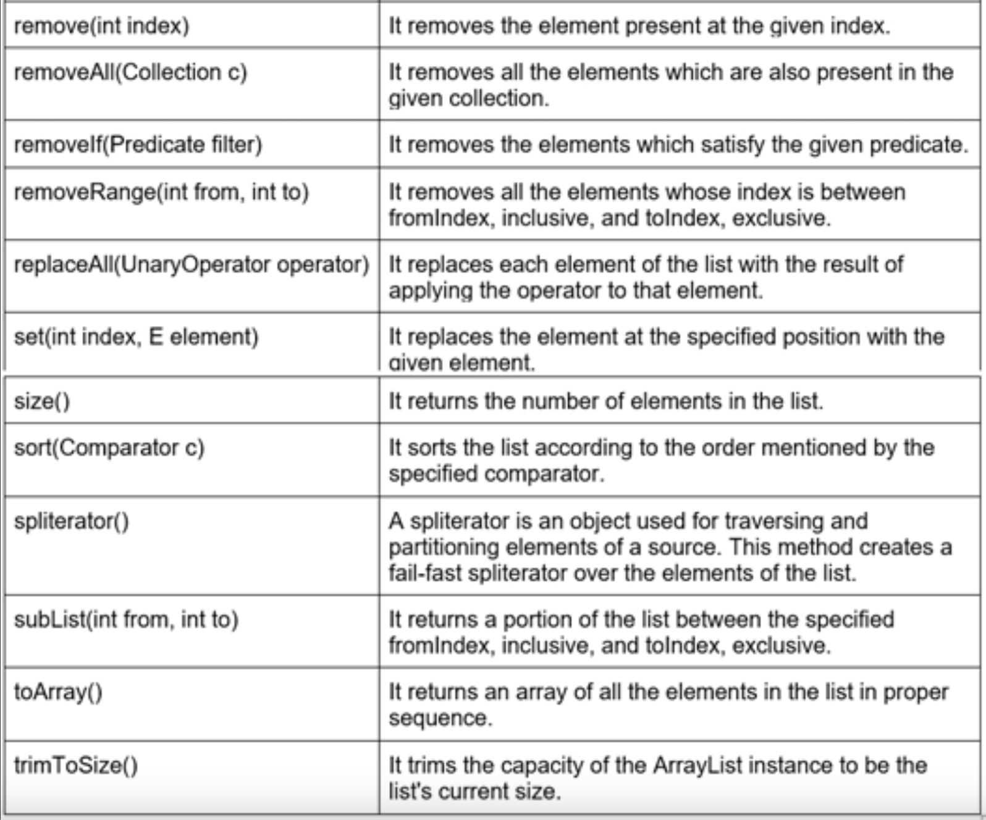
1. Introduction to Data Structure
1.1. types of data structures
1.2. Importance of Data Structure
2. Collection framework in Java
2.1.Introduction
2.2. Collection framework
2.3. Framework
2.4. Need for a Separate Collection Framework
2.5. All Collection Framework contain
2.5.1. Interfaces
2.5.2. Implementation
2.5.3. Algorithm
2.6. Java Collection Framework Hierarchy
2.7. Methods of Collection interface
3. Iterator Interface
4. Iterable Interface
5. Collection Interface
5.1. List Interface
5.2. ArrayList
5.2.1. ArrayList methods
5.3. LinkedList
5.3.1. LinkedList methods
5.4. ArrayList Vs LinkedList
5.6. Stack
6. Queue Interface
6.1. Priority Queue
6.2. Deque Interface
6.3. ArrayDeque
7. Set Interface
7.1. HashSet
7.2. LinkedHashSet
7.3. SortedSet Interface
7.4. TreeSet
8. Java Map Interface
8.1. HashMap
8.1.1 Hashmap declaration in Java
8.1.2 Java Hashmap Example
8.2. Linked HashMap Interface
8.2.1. Linked HashMap declaration in Java
8.2.2. Java Linked HashMap Example
8.3. Java TreeMap Class
8.3.1. TreeMap declaration in Java
9. Collection Sort in Java
10. Binary Search in Java
10.1. Implementation of Binary Search
11. Stack
11.1 Stack Class Java
11.2 Initialization of stack in Java
11.3 Methods of Stack class
12 CRUD operation in ArrayList
12.1. Adding to an ArrayList
12.2. Updating in an ArrayList
12.3. Deleting from an ArrayList
13. Data Access Object(DAO) Pattern
13.1. Implementation of DAO
ArrayList methods

Slide 30
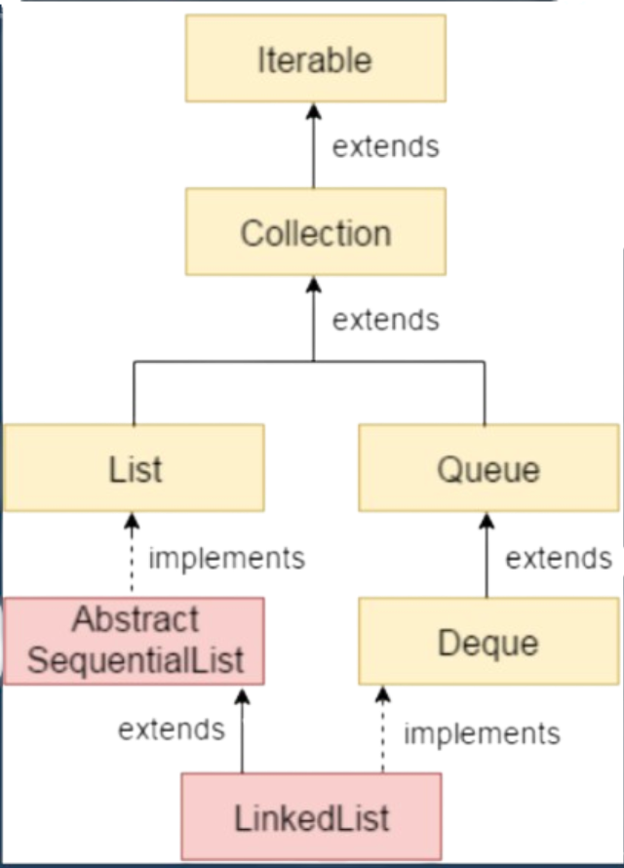
1. Introduction to Data Structure
1.1. types of data structures
1.2. Importance of Data Structure
2. Collection framework in Java
2.1.Introduction
2.2. Collection framework
2.3. Framework
2.4. Need for a Separate Collection Framework
2.5. All Collection Framework contain
2.5.1. Interfaces
2.5.2. Implementation
2.5.3. Algorithm
2.6. Java Collection Framework Hierarchy
2.7. Methods of Collection interface
3. Iterator Interface
4. Iterable Interface
5. Collection Interface
5.1. List Interface
5.2. ArrayList
5.2.1. ArrayList methods
5.3. LinkedList
5.3.1. LinkedList methods
5.4. ArrayList Vs LinkedList
5.6. Stack
6. Queue Interface
6.1. Priority Queue
6.2. Deque Interface
6.3. ArrayDeque
7. Set Interface
7.1. HashSet
7.2. LinkedHashSet
7.3. SortedSet Interface
7.4. TreeSet
8. Java Map Interface
8.1. HashMap
8.1.1 Hashmap declaration in Java
8.1.2 Java Hashmap Example
8.2. Linked HashMap Interface
8.2.1. Linked HashMap declaration in Java
8.2.2. Java Linked HashMap Example
8.3. Java TreeMap Class
8.3.1. TreeMap declaration in Java
9. Collection Sort in Java
10. Binary Search in Java
10.1. Implementation of Binary Search
11. Stack
11.1 Stack Class Java
11.2 Initialization of stack in Java
11.3 Methods of Stack class
12 CRUD operation in ArrayList
12.1. Adding to an ArrayList
12.2. Updating in an ArrayList
12.3. Deleting from an ArrayList
13. Data Access Object(DAO) Pattern
13.1. Implementation of DAO
LinkedList
Java LinkedList class can contain duplicate elements.
Java LinkedList class maintains insertion order.
Java LinkedList class is non synchronized.
In Java LinkedList class, manipulation is fast because no shifting needs to occur.
Java LinkedList class can be used as a list, stack or queue.

Slide 31
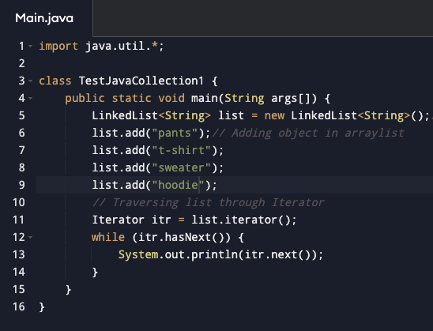
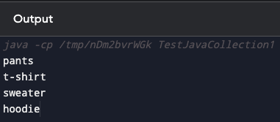
1. Introduction to Data Structure
1.1. types of data structures
1.2. Importance of Data Structure
2. Collection framework in Java
2.1.Introduction
2.2. Collection framework
2.3. Framework
2.4. Need for a Separate Collection Framework
2.5. All Collection Framework contain
2.5.1. Interfaces
2.5.2. Implementation
2.5.3. Algorithm
2.6. Java Collection Framework Hierarchy
2.7. Methods of Collection interface
3. Iterator Interface
4. Iterable Interface
5. Collection Interface
5.1. List Interface
5.2. ArrayList
5.2.1. ArrayList methods
5.3. LinkedList
5.3.1. LinkedList methods
5.4. ArrayList Vs LinkedList
5.6. Stack
6. Queue Interface
6.1. Priority Queue
6.2. Deque Interface
6.3. ArrayDeque
7. Set Interface
7.1. HashSet
7.2. LinkedHashSet
7.3. SortedSet Interface
7.4. TreeSet
8. Java Map Interface
8.1. HashMap
8.1.1 Hashmap declaration in Java
8.1.2 Java Hashmap Example
8.2. Linked HashMap Interface
8.2.1. Linked HashMap declaration in Java
8.2.2. Java Linked HashMap Example
8.3. Java TreeMap Class
8.3.1. TreeMap declaration in Java
9. Collection Sort in Java
10. Binary Search in Java
10.1. Implementation of Binary Search
11. Stack
11.1 Stack Class Java
11.2 Initialization of stack in Java
11.3 Methods of Stack class
12 CRUD operation in ArrayList
12.1. Adding to an ArrayList
12.2. Updating in an ArrayList
12.3. Deleting from an ArrayList
13. Data Access Object(DAO) Pattern
13.1. Implementation of DAO
LinkedList

Slide 32
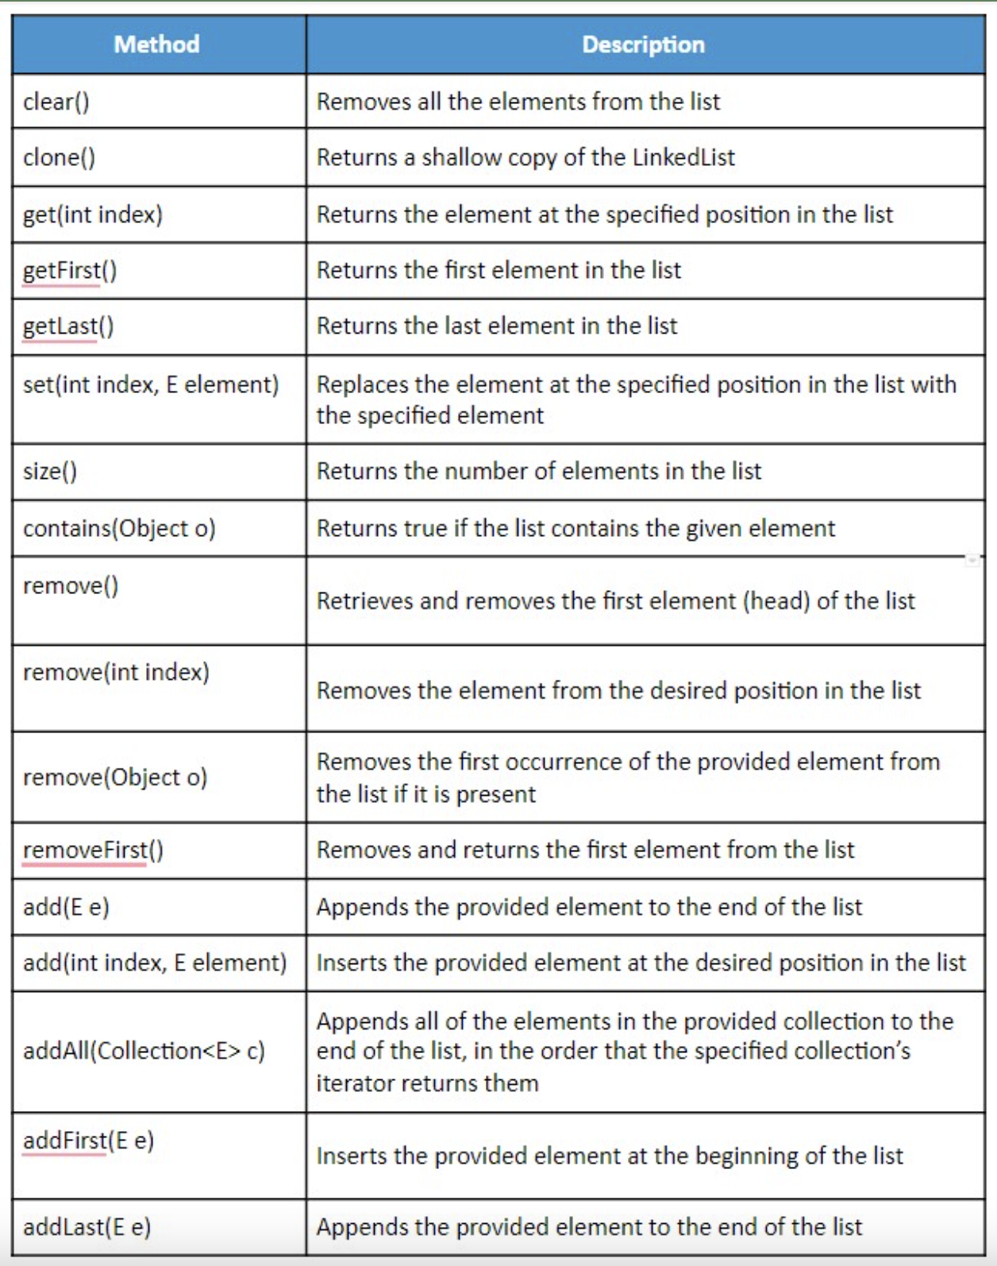
1. Introduction to Data Structure
1.1. types of data structures
1.2. Importance of Data Structure
2. Collection framework in Java
2.1.Introduction
2.2. Collection framework
2.3. Framework
2.4. Need for a Separate Collection Framework
2.5. All Collection Framework contain
2.5.1. Interfaces
2.5.2. Implementation
2.5.3. Algorithm
2.6. Java Collection Framework Hierarchy
2.7. Methods of Collection interface
3. Iterator Interface
4. Iterable Interface
5. Collection Interface
5.1. List Interface
5.2. ArrayList
5.2.1. ArrayList methods
5.3. LinkedList
5.3.1. LinkedList methods
5.4. ArrayList Vs LinkedList
5.6. Stack
6. Queue Interface
6.1. Priority Queue
6.2. Deque Interface
6.3. ArrayDeque
7. Set Interface
7.1. HashSet
7.2. LinkedHashSet
7.3. SortedSet Interface
7.4. TreeSet
8. Java Map Interface
8.1. HashMap
8.1.1 Hashmap declaration in Java
8.1.2 Java Hashmap Example
8.2. Linked HashMap Interface
8.2.1. Linked HashMap declaration in Java
8.2.2. Java Linked HashMap Example
8.3. Java TreeMap Class
8.3.1. TreeMap declaration in Java
9. Collection Sort in Java
10. Binary Search in Java
10.1. Implementation of Binary Search
11. Stack
11.1 Stack Class Java
11.2 Initialization of stack in Java
11.3 Methods of Stack class
12 CRUD operation in ArrayList
12.1. Adding to an ArrayList
12.2. Updating in an ArrayList
12.3. Deleting from an ArrayList
13. Data Access Object(DAO) Pattern
13.1. Implementation of DAO
LinkedList methods

Slide 33
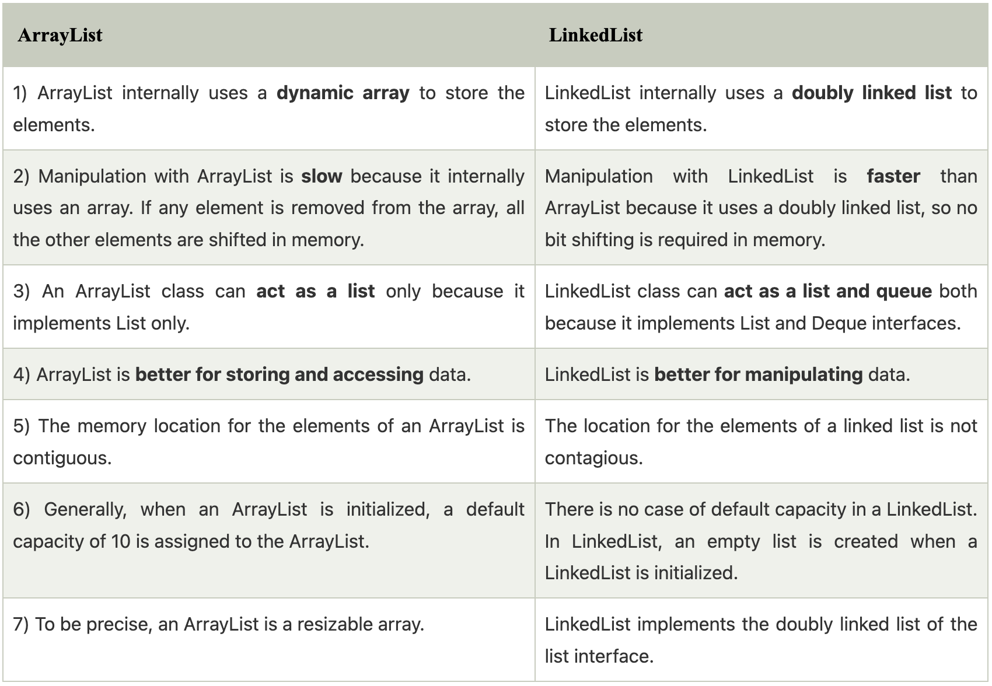
1. Introduction to Data Structure
1.1. types of data structures
1.2. Importance of Data Structure
2. Collection framework in Java
2.1.Introduction
2.2. Collection framework
2.3. Framework
2.4. Need for a Separate Collection Framework
2.5. All Collection Framework contain
2.5.1. Interfaces
2.5.2. Implementation
2.5.3. Algorithm
2.6. Java Collection Framework Hierarchy
2.7. Methods of Collection interface
3. Iterator Interface
4. Iterable Interface
5. Collection Interface
5.1. List Interface
5.2. ArrayList
5.2.1. ArrayList methods
5.3. LinkedList
5.3.1. LinkedList methods
5.4. ArrayList Vs LinkedList
5.6. Stack
6. Queue Interface
6.1. Priority Queue
6.2. Deque Interface
6.3. ArrayDeque
7. Set Interface
7.1. HashSet
7.2. LinkedHashSet
7.3. SortedSet Interface
7.4. TreeSet
8. Java Map Interface
8.1. HashMap
8.1.1 Hashmap declaration in Java
8.1.2 Java Hashmap Example
8.2. Linked HashMap Interface
8.2.1. Linked HashMap declaration in Java
8.2.2. Java Linked HashMap Example
8.3. Java TreeMap Class
8.3.1. TreeMap declaration in Java
9. Collection Sort in Java
10. Binary Search in Java
10.1. Implementation of Binary Search
11. Stack
11.1 Stack Class Java
11.2 Initialization of stack in Java
11.3 Methods of Stack class
12 CRUD operation in ArrayList
12.1. Adding to an ArrayList
12.2. Updating in an ArrayList
12.3. Deleting from an ArrayList
13. Data Access Object(DAO) Pattern
13.1. Implementation of DAO
ArrayList vs LinkedList

Slide 34
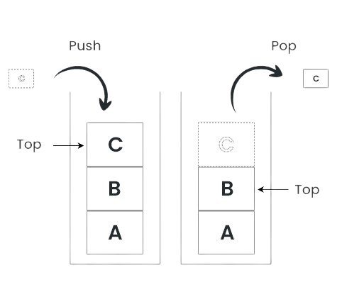
1. Introduction to Data Structure
1.1. types of data structures
1.2. Importance of Data Structure
2. Collection framework in Java
2.1.Introduction
2.2. Collection framework
2.3. Framework
2.4. Need for a Separate Collection Framework
2.5. All Collection Framework contain
2.5.1. Interfaces
2.5.2. Implementation
2.5.3. Algorithm
2.6. Java Collection Framework Hierarchy
2.7. Methods of Collection interface
3. Iterator Interface
4. Iterable Interface
5. Collection Interface
5.1. List Interface
5.2. ArrayList
5.2.1. ArrayList methods
5.3. LinkedList
5.3.1. LinkedList methods
5.4. ArrayList Vs LinkedList
5.6. Stack
6. Queue Interface
6.1. Priority Queue
6.2. Deque Interface
6.3. ArrayDeque
7. Set Interface
7.1. HashSet
7.2. LinkedHashSet
7.3. SortedSet Interface
7.4. TreeSet
8. Java Map Interface
8.1. HashMap
8.1.1 Hashmap declaration in Java
8.1.2 Java Hashmap Example
8.2. Linked HashMap Interface
8.2.1. Linked HashMap declaration in Java
8.2.2. Java Linked HashMap Example
8.3. Java TreeMap Class
8.3.1. TreeMap declaration in Java
9. Collection Sort in Java
10. Binary Search in Java
10.1. Implementation of Binary Search
11. Stack
11.1 Stack Class Java
11.2 Initialization of stack in Java
11.3 Methods of Stack class
12 CRUD operation in ArrayList
12.1. Adding to an ArrayList
12.2. Updating in an ArrayList
12.3. Deleting from an ArrayList
13. Data Access Object(DAO) Pattern
13.1. Implementation of DAO
Stack
The stack is the subclass of Vector.
It implements the last-in-first-out data structure, i.e., Stack.
The stack contains all of the methods of Vector class and also provides its methods like boolean push(), boolean peek(), boolean push(object o), which defines its properties.

Slide 35
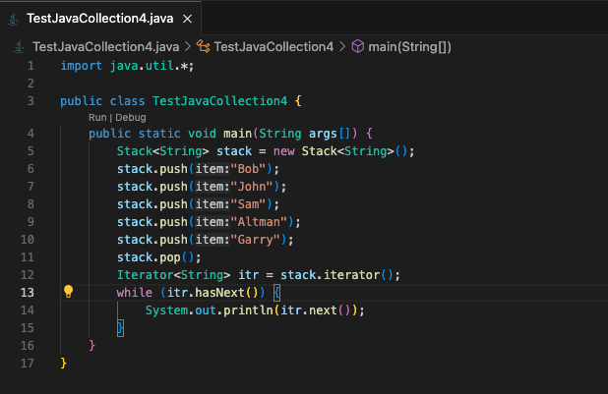
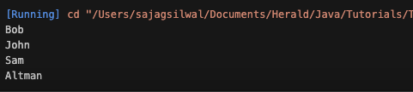
1. Introduction to Data Structure
1.1. types of data structures
1.2. Importance of Data Structure
2. Collection framework in Java
2.1.Introduction
2.2. Collection framework
2.3. Framework
2.4. Need for a Separate Collection Framework
2.5. All Collection Framework contain
2.5.1. Interfaces
2.5.2. Implementation
2.5.3. Algorithm
2.6. Java Collection Framework Hierarchy
2.7. Methods of Collection interface
3. Iterator Interface
4. Iterable Interface
5. Collection Interface
5.1. List Interface
5.2. ArrayList
5.2.1. ArrayList methods
5.3. LinkedList
5.3.1. LinkedList methods
5.4. ArrayList Vs LinkedList
5.6. Stack
6. Queue Interface
6.1. Priority Queue
6.2. Deque Interface
6.3. ArrayDeque
7. Set Interface
7.1. HashSet
7.2. LinkedHashSet
7.3. SortedSet Interface
7.4. TreeSet
8. Java Map Interface
8.1. HashMap
8.1.1 Hashmap declaration in Java
8.1.2 Java Hashmap Example
8.2. Linked HashMap Interface
8.2.1. Linked HashMap declaration in Java
8.2.2. Java Linked HashMap Example
8.3. Java TreeMap Class
8.3.1. TreeMap declaration in Java
9. Collection Sort in Java
10. Binary Search in Java
10.1. Implementation of Binary Search
11. Stack
11.1 Stack Class Java
11.2 Initialization of stack in Java
11.3 Methods of Stack class
12 CRUD operation in ArrayList
12.1. Adding to an ArrayList
12.2. Updating in an ArrayList
12.3. Deleting from an ArrayList
13. Data Access Object(DAO) Pattern
13.1. Implementation of DAO
Stack
Output:

Slide 36
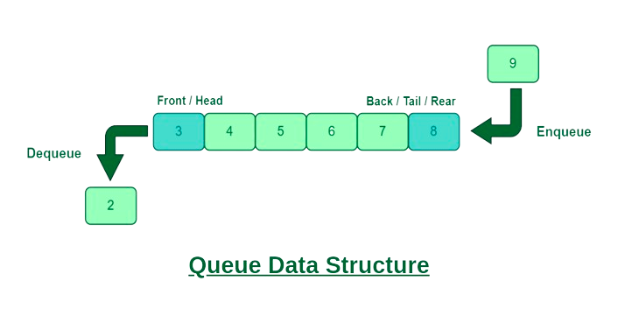
1. Introduction to Data Structure
1.1. types of data structures
1.2. Importance of Data Structure
2. Collection framework in Java
2.1.Introduction
2.2. Collection framework
2.3. Framework
2.4. Need for a Separate Collection Framework
2.5. All Collection Framework contain
2.5.1. Interfaces
2.5.2. Implementation
2.5.3. Algorithm
2.6. Java Collection Framework Hierarchy
2.7. Methods of Collection interface
3. Iterator Interface
4. Iterable Interface
5. Collection Interface
5.1. List Interface
5.2. ArrayList
5.2.1. ArrayList methods
5.3. LinkedList
5.3.1. LinkedList methods
5.4. ArrayList Vs LinkedList
5.6. Stack
6. Queue Interface
6.1. Priority Queue
6.2. Deque Interface
6.3. ArrayDeque
7. Set Interface
7.1. HashSet
7.2. LinkedHashSet
7.3. SortedSet Interface
7.4. TreeSet
8. Java Map Interface
8.1. HashMap
8.1.1 Hashmap declaration in Java
8.1.2 Java Hashmap Example
8.2. Linked HashMap Interface
8.2.1. Linked HashMap declaration in Java
8.2.2. Java Linked HashMap Example
8.3. Java TreeMap Class
8.3.1. TreeMap declaration in Java
9. Collection Sort in Java
10. Binary Search in Java
10.1. Implementation of Binary Search
11. Stack
11.1 Stack Class Java
11.2 Initialization of stack in Java
11.3 Methods of Stack class
12 CRUD operation in ArrayList
12.1. Adding to an ArrayList
12.2. Updating in an ArrayList
12.3. Deleting from an ArrayList
13. Data Access Object(DAO) Pattern
13.1. Implementation of DAO
Queue Interface
Queue interface maintains the first-in-first-out order.
It can be defined as an ordered list that is used to hold the elements which are about to be processed.
There are various classes like PriorityQueue, Deque, and ArrayDeque which implements the Queue interface.

Slide 37
1. Introduction to Data Structure
1.1. types of data structures
1.2. Importance of Data Structure
2. Collection framework in Java
2.1.Introduction
2.2. Collection framework
2.3. Framework
2.4. Need for a Separate Collection Framework
2.5. All Collection Framework contain
2.5.1. Interfaces
2.5.2. Implementation
2.5.3. Algorithm
2.6. Java Collection Framework Hierarchy
2.7. Methods of Collection interface
3. Iterator Interface
4. Iterable Interface
5. Collection Interface
5.1. List Interface
5.2. ArrayList
5.2.1. ArrayList methods
5.3. LinkedList
5.3.1. LinkedList methods
5.4. ArrayList Vs LinkedList
5.6. Stack
6. Queue Interface
6.1. Priority Queue
6.2. Deque Interface
6.3. ArrayDeque
7. Set Interface
7.1. HashSet
7.2. LinkedHashSet
7.3. SortedSet Interface
7.4. TreeSet
8. Java Map Interface
8.1. HashMap
8.1.1 Hashmap declaration in Java
8.1.2 Java Hashmap Example
8.2. Linked HashMap Interface
8.2.1. Linked HashMap declaration in Java
8.2.2. Java Linked HashMap Example
8.3. Java TreeMap Class
8.3.1. TreeMap declaration in Java
9. Collection Sort in Java
10. Binary Search in Java
10.1. Implementation of Binary Search
11. Stack
11.1 Stack Class Java
11.2 Initialization of stack in Java
11.3 Methods of Stack class
12 CRUD operation in ArrayList
12.1. Adding to an ArrayList
12.2. Updating in an ArrayList
12.3. Deleting from an ArrayList
13. Data Access Object(DAO) Pattern
13.1. Implementation of DAO
Queue Interface
The Java Queue provides support for all of the methods of the Collection interface including deletion, insertion, etc.
Those Queues that are present in the util package are known as Unbounded Queues.
Those Queues that are present in the util.concurrent package are known as bounded Queues.
All Queues barring the Deques facilitates removal and insertion at the head and tail of the queue; respectively. In fact, deques support element insertion and removal at both ends.

Slide 38
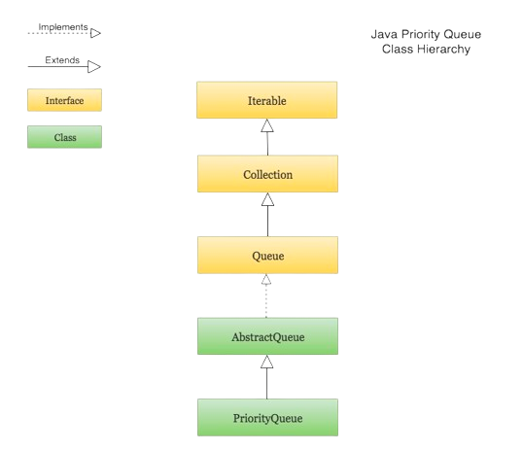
1. Introduction to Data Structure
1.1. types of data structures
1.2. Importance of Data Structure
2. Collection framework in Java
2.1.Introduction
2.2. Collection framework
2.3. Framework
2.4. Need for a Separate Collection Framework
2.5. All Collection Framework contain
2.5.1. Interfaces
2.5.2. Implementation
2.5.3. Algorithm
2.6. Java Collection Framework Hierarchy
2.7. Methods of Collection interface
3. Iterator Interface
4. Iterable Interface
5. Collection Interface
5.1. List Interface
5.2. ArrayList
5.2.1. ArrayList methods
5.3. LinkedList
5.3.1. LinkedList methods
5.4. ArrayList Vs LinkedList
5.6. Stack
6. Queue Interface
6.1. Priority Queue
6.2. Deque Interface
6.3. ArrayDeque
7. Set Interface
7.1. HashSet
7.2. LinkedHashSet
7.3. SortedSet Interface
7.4. TreeSet
8. Java Map Interface
8.1. HashMap
8.1.1 Hashmap declaration in Java
8.1.2 Java Hashmap Example
8.2. Linked HashMap Interface
8.2.1. Linked HashMap declaration in Java
8.2.2. Java Linked HashMap Example
8.3. Java TreeMap Class
8.3.1. TreeMap declaration in Java
9. Collection Sort in Java
10. Binary Search in Java
10.1. Implementation of Binary Search
11. Stack
11.1 Stack Class Java
11.2 Initialization of stack in Java
11.3 Methods of Stack class
12 CRUD operation in ArrayList
12.1. Adding to an ArrayList
12.2. Updating in an ArrayList
12.3. Deleting from an ArrayList
13. Data Access Object(DAO) Pattern
13.1. Implementation of DAO
Priority Queue
The PriorityQueue class implements the Queue interface.
It holds the elements or objects which are to be processed by their priorities.
PriorityQueue doesn't allow null values to be stored in the queue.

Slide 39
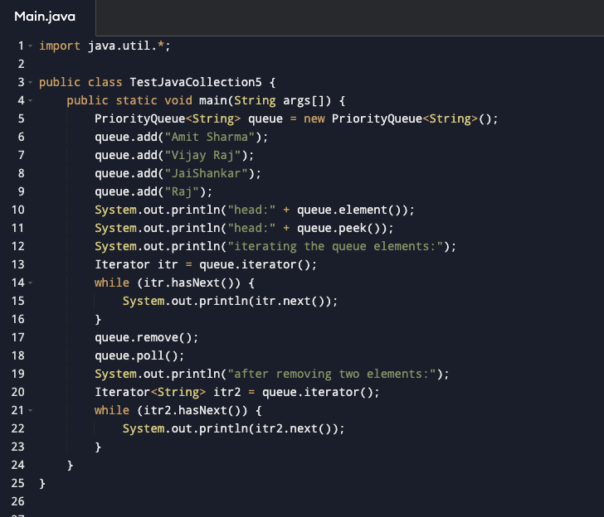
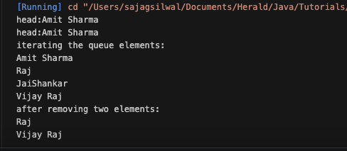
1. Introduction to Data Structure
1.1. types of data structures
1.2. Importance of Data Structure
2. Collection framework in Java
2.1.Introduction
2.2. Collection framework
2.3. Framework
2.4. Need for a Separate Collection Framework
2.5. All Collection Framework contain
2.5.1. Interfaces
2.5.2. Implementation
2.5.3. Algorithm
2.6. Java Collection Framework Hierarchy
2.7. Methods of Collection interface
3. Iterator Interface
4. Iterable Interface
5. Collection Interface
5.1. List Interface
5.2. ArrayList
5.2.1. ArrayList methods
5.3. LinkedList
5.3.1. LinkedList methods
5.4. ArrayList Vs LinkedList
5.6. Stack
6. Queue Interface
6.1. Priority Queue
6.2. Deque Interface
6.3. ArrayDeque
7. Set Interface
7.1. HashSet
7.2. LinkedHashSet
7.3. SortedSet Interface
7.4. TreeSet
8. Java Map Interface
8.1. HashMap
8.1.1 Hashmap declaration in Java
8.1.2 Java Hashmap Example
8.2. Linked HashMap Interface
8.2.1. Linked HashMap declaration in Java
8.2.2. Java Linked HashMap Example
8.3. Java TreeMap Class
8.3.1. TreeMap declaration in Java
9. Collection Sort in Java
10. Binary Search in Java
10.1. Implementation of Binary Search
11. Stack
11.1 Stack Class Java
11.2 Initialization of stack in Java
11.3 Methods of Stack class
12 CRUD operation in ArrayList
12.1. Adding to an ArrayList
12.2. Updating in an ArrayList
12.3. Deleting from an ArrayList
13. Data Access Object(DAO) Pattern
13.1. Implementation of DAO
Priority Queue
Output:

Slide 40
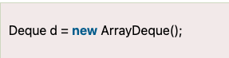
1. Introduction to Data Structure
1.1. types of data structures
1.2. Importance of Data Structure
2. Collection framework in Java
2.1.Introduction
2.2. Collection framework
2.3. Framework
2.4. Need for a Separate Collection Framework
2.5. All Collection Framework contain
2.5.1. Interfaces
2.5.2. Implementation
2.5.3. Algorithm
2.6. Java Collection Framework Hierarchy
2.7. Methods of Collection interface
3. Iterator Interface
4. Iterable Interface
5. Collection Interface
5.1. List Interface
5.2. ArrayList
5.2.1. ArrayList methods
5.3. LinkedList
5.3.1. LinkedList methods
5.4. ArrayList Vs LinkedList
5.6. Stack
6. Queue Interface
6.1. Priority Queue
6.2. Deque Interface
6.3. ArrayDeque
7. Set Interface
7.1. HashSet
7.2. LinkedHashSet
7.3. SortedSet Interface
7.4. TreeSet
8. Java Map Interface
8.1. HashMap
8.1.1 Hashmap declaration in Java
8.1.2 Java Hashmap Example
8.2. Linked HashMap Interface
8.2.1. Linked HashMap declaration in Java
8.2.2. Java Linked HashMap Example
8.3. Java TreeMap Class
8.3.1. TreeMap declaration in Java
9. Collection Sort in Java
10. Binary Search in Java
10.1. Implementation of Binary Search
11. Stack
11.1 Stack Class Java
11.2 Initialization of stack in Java
11.3 Methods of Stack class
12 CRUD operation in ArrayList
12.1. Adding to an ArrayList
12.2. Updating in an ArrayList
12.3. Deleting from an ArrayList
13. Data Access Object(DAO) Pattern
13.1. Implementation of DAO
Deque Interface
Deque interface extends the Queue interface. In Deque, we
can remove and add the elements from both the side.
Deque stands for a double-ended queue which enables us to perform the operations at both the ends.
Deque can be instantiated as:

Slide 41
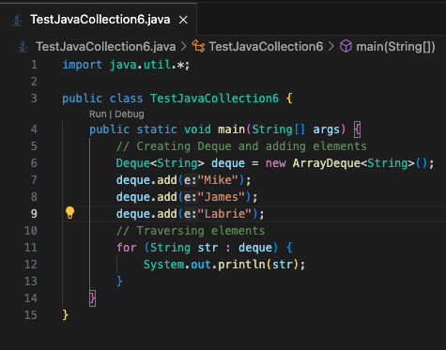
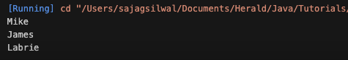
1. Introduction to Data Structure
1.1. types of data structures
1.2. Importance of Data Structure
2. Collection framework in Java
2.1.Introduction
2.2. Collection framework
2.3. Framework
2.4. Need for a Separate Collection Framework
2.5. All Collection Framework contain
2.5.1. Interfaces
2.5.2. Implementation
2.5.3. Algorithm
2.6. Java Collection Framework Hierarchy
2.7. Methods of Collection interface
3. Iterator Interface
4. Iterable Interface
5. Collection Interface
5.1. List Interface
5.2. ArrayList
5.2.1. ArrayList methods
5.3. LinkedList
5.3.1. LinkedList methods
5.4. ArrayList Vs LinkedList
5.6. Stack
6. Queue Interface
6.1. Priority Queue
6.2. Deque Interface
6.3. ArrayDeque
7. Set Interface
7.1. HashSet
7.2. LinkedHashSet
7.3. SortedSet Interface
7.4. TreeSet
8. Java Map Interface
8.1. HashMap
8.1.1 Hashmap declaration in Java
8.1.2 Java Hashmap Example
8.2. Linked HashMap Interface
8.2.1. Linked HashMap declaration in Java
8.2.2. Java Linked HashMap Example
8.3. Java TreeMap Class
8.3.1. TreeMap declaration in Java
9. Collection Sort in Java
10. Binary Search in Java
10.1. Implementation of Binary Search
11. Stack
11.1 Stack Class Java
11.2 Initialization of stack in Java
11.3 Methods of Stack class
12 CRUD operation in ArrayList
12.1. Adding to an ArrayList
12.2. Updating in an ArrayList
12.3. Deleting from an ArrayList
13. Data Access Object(DAO) Pattern
13.1. Implementation of DAO
ArrayDeque
ArrayDeque class implements the Deque interface.
It facilitates us to use the Deque.
Unlike queue, we can add or delete the elements from both the ends.
ArrayDeque is faster than ArrayList and Stack and has no capacity restrictions.

Slide 42
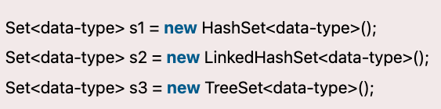
1. Introduction to Data Structure
1.1. types of data structures
1.2. Importance of Data Structure
2. Collection framework in Java
2.1.Introduction
2.2. Collection framework
2.3. Framework
2.4. Need for a Separate Collection Framework
2.5. All Collection Framework contain
2.5.1. Interfaces
2.5.2. Implementation
2.5.3. Algorithm
2.6. Java Collection Framework Hierarchy
2.7. Methods of Collection interface
3. Iterator Interface
4. Iterable Interface
5. Collection Interface
5.1. List Interface
5.2. ArrayList
5.2.1. ArrayList methods
5.3. LinkedList
5.3.1. LinkedList methods
5.4. ArrayList Vs LinkedList
5.6. Stack
6. Queue Interface
6.1. Priority Queue
6.2. Deque Interface
6.3. ArrayDeque
7. Set Interface
7.1. HashSet
7.2. LinkedHashSet
7.3. SortedSet Interface
7.4. TreeSet
8. Java Map Interface
8.1. HashMap
8.1.1 Hashmap declaration in Java
8.1.2 Java Hashmap Example
8.2. Linked HashMap Interface
8.2.1. Linked HashMap declaration in Java
8.2.2. Java Linked HashMap Example
8.3. Java TreeMap Class
8.3.1. TreeMap declaration in Java
9. Collection Sort in Java
10. Binary Search in Java
10.1. Implementation of Binary Search
11. Stack
11.1 Stack Class Java
11.2 Initialization of stack in Java
11.3 Methods of Stack class
12 CRUD operation in ArrayList
12.1. Adding to an ArrayList
12.2. Updating in an ArrayList
12.3. Deleting from an ArrayList
13. Data Access Object(DAO) Pattern
13.1. Implementation of DAO
Set Interface
Set Interface in Java is present in java.util package.
It extends the Collection interface. It represents the unordered set of elements which doesn't allow us to store the duplicate items.
We can store at most one null value in Set. Set is implemented by HashSet, LinkedHashSet, and TreeSet
Set in collection framework can be instantiated as:

Slide 43
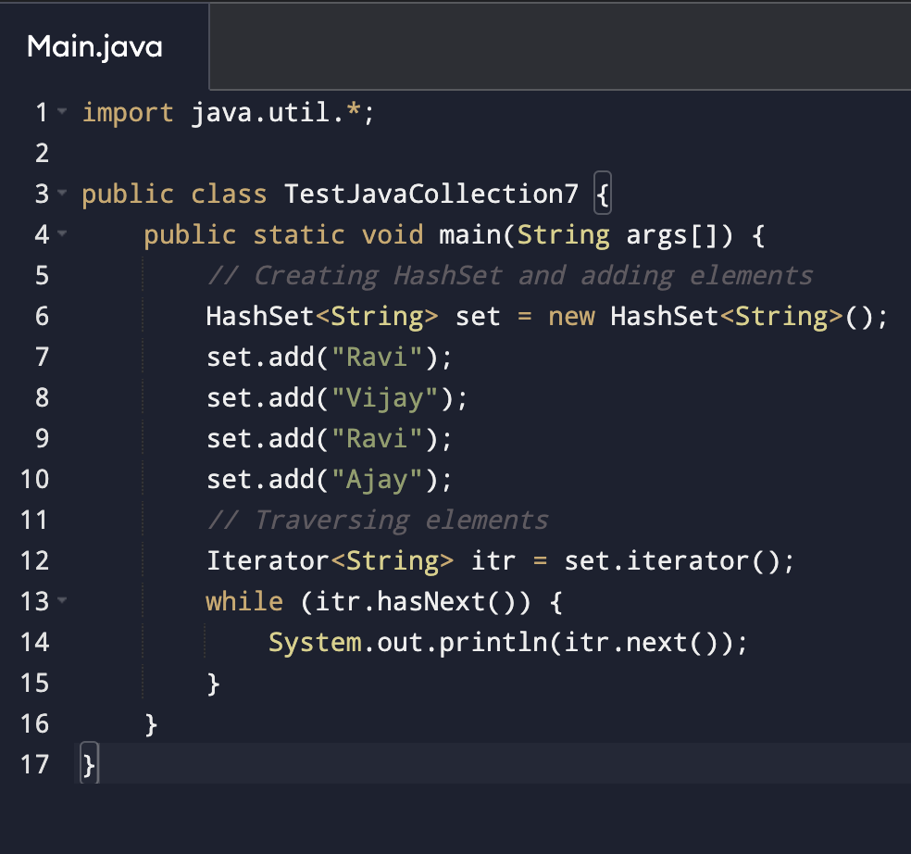
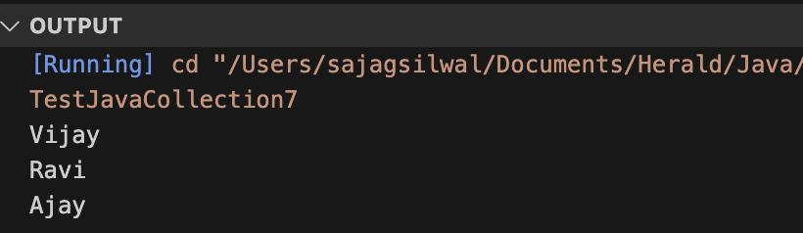
1. Introduction to Data Structure
1.1. types of data structures
1.2. Importance of Data Structure
2. Collection framework in Java
2.1.Introduction
2.2. Collection framework
2.3. Framework
2.4. Need for a Separate Collection Framework
2.5. All Collection Framework contain
2.5.1. Interfaces
2.5.2. Implementation
2.5.3. Algorithm
2.6. Java Collection Framework Hierarchy
2.7. Methods of Collection interface
3. Iterator Interface
4. Iterable Interface
5. Collection Interface
5.1. List Interface
5.2. ArrayList
5.2.1. ArrayList methods
5.3. LinkedList
5.3.1. LinkedList methods
5.4. ArrayList Vs LinkedList
5.6. Stack
6. Queue Interface
6.1. Priority Queue
6.2. Deque Interface
6.3. ArrayDeque
7. Set Interface
7.1. HashSet
7.2. LinkedHashSet
7.3. SortedSet Interface
7.4. TreeSet
8. Java Map Interface
8.1. HashMap
8.1.1 Hashmap declaration in Java
8.1.2 Java Hashmap Example
8.2. Linked HashMap Interface
8.2.1. Linked HashMap declaration in Java
8.2.2. Java Linked HashMap Example
8.3. Java TreeMap Class
8.3.1. TreeMap declaration in Java
9. Collection Sort in Java
10. Binary Search in Java
10.1. Implementation of Binary Search
11. Stack
11.1 Stack Class Java
11.2 Initialization of stack in Java
11.3 Methods of Stack class
12 CRUD operation in ArrayList
12.1. Adding to an ArrayList
12.2. Updating in an ArrayList
12.3. Deleting from an ArrayList
13. Data Access Object(DAO) Pattern
13.1. Implementation of DAO
HashSet
HashSet class implements Set Interface.
It represents the collection that uses a hash table for storage.
Hashing is used to store the elements in the HashSet.
It contains unique items.

Slide 44
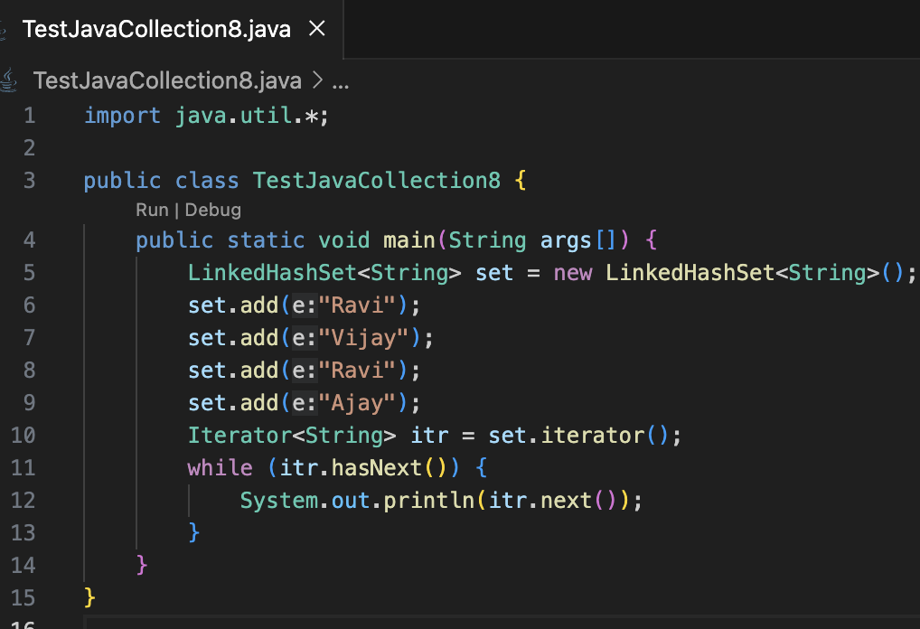
1. Introduction to Data Structure
1.1. types of data structures
1.2. Importance of Data Structure
2. Collection framework in Java
2.1.Introduction
2.2. Collection framework
2.3. Framework
2.4. Need for a Separate Collection Framework
2.5. All Collection Framework contain
2.5.1. Interfaces
2.5.2. Implementation
2.5.3. Algorithm
2.6. Java Collection Framework Hierarchy
2.7. Methods of Collection interface
3. Iterator Interface
4. Iterable Interface
5. Collection Interface
5.1. List Interface
5.2. ArrayList
5.2.1. ArrayList methods
5.3. LinkedList
5.3.1. LinkedList methods
5.4. ArrayList Vs LinkedList
5.6. Stack
6. Queue Interface
6.1. Priority Queue
6.2. Deque Interface
6.3. ArrayDeque
7. Set Interface
7.1. HashSet
7.2. LinkedHashSet
7.3. SortedSet Interface
7.4. TreeSet
8. Java Map Interface
8.1. HashMap
8.1.1 Hashmap declaration in Java
8.1.2 Java Hashmap Example
8.2. Linked HashMap Interface
8.2.1. Linked HashMap declaration in Java
8.2.2. Java Linked HashMap Example
8.3. Java TreeMap Class
8.3.1. TreeMap declaration in Java
9. Collection Sort in Java
10. Binary Search in Java
10.1. Implementation of Binary Search
11. Stack
11.1 Stack Class Java
11.2 Initialization of stack in Java
11.3 Methods of Stack class
12 CRUD operation in ArrayList
12.1. Adding to an ArrayList
12.2. Updating in an ArrayList
12.3. Deleting from an ArrayList
13. Data Access Object(DAO) Pattern
13.1. Implementation of DAO
LinkedHashSet
LinkedHashSet class represents the LinkedList implementation of Set Interface.
It extends the HashSet class and implements Set interface.
Like HashSet, It also contains unique elements.
It maintains the insertion order and permits null elements.

Slide 45
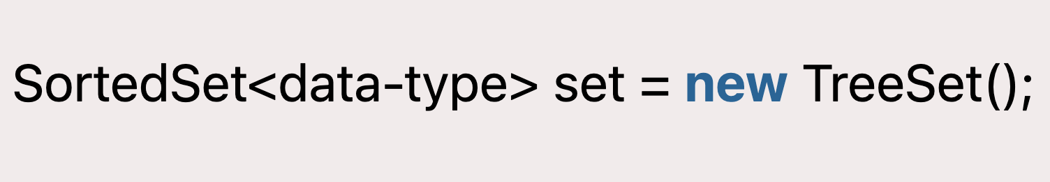
1. Introduction to Data Structure
1.1. types of data structures
1.2. Importance of Data Structure
2. Collection framework in Java
2.1.Introduction
2.2. Collection framework
2.3. Framework
2.4. Need for a Separate Collection Framework
2.5. All Collection Framework contain
2.5.1. Interfaces
2.5.2. Implementation
2.5.3. Algorithm
2.6. Java Collection Framework Hierarchy
2.7. Methods of Collection interface
3. Iterator Interface
4. Iterable Interface
5. Collection Interface
5.1. List Interface
5.2. ArrayList
5.2.1. ArrayList methods
5.3. LinkedList
5.3.1. LinkedList methods
5.4. ArrayList Vs LinkedList
5.6. Stack
6. Queue Interface
6.1. Priority Queue
6.2. Deque Interface
6.3. ArrayDeque
7. Set Interface
7.1. HashSet
7.2. LinkedHashSet
7.3. SortedSet Interface
7.4. TreeSet
8. Java Map Interface
8.1. HashMap
8.1.1 Hashmap declaration in Java
8.1.2 Java Hashmap Example
8.2. Linked HashMap Interface
8.2.1. Linked HashMap declaration in Java
8.2.2. Java Linked HashMap Example
8.3. Java TreeMap Class
8.3.1. TreeMap declaration in Java
9. Collection Sort in Java
10. Binary Search in Java
10.1. Implementation of Binary Search
11. Stack
11.1 Stack Class Java
11.2 Initialization of stack in Java
11.3 Methods of Stack class
12 CRUD operation in ArrayList
12.1. Adding to an ArrayList
12.2. Updating in an ArrayList
12.3. Deleting from an ArrayList
13. Data Access Object(DAO) Pattern
13.1. Implementation of DAO
SortedSet Interface
SortedSet is the alternate of Set interface that provides a total ordering on its elements.
The elements of the SortedSet are arranged in the increasing (ascending) order.
The SortedSet provides the additional methods that inhibit the natural ordering of the elements.
The SortedSet can be instantiated as:

Slide 46
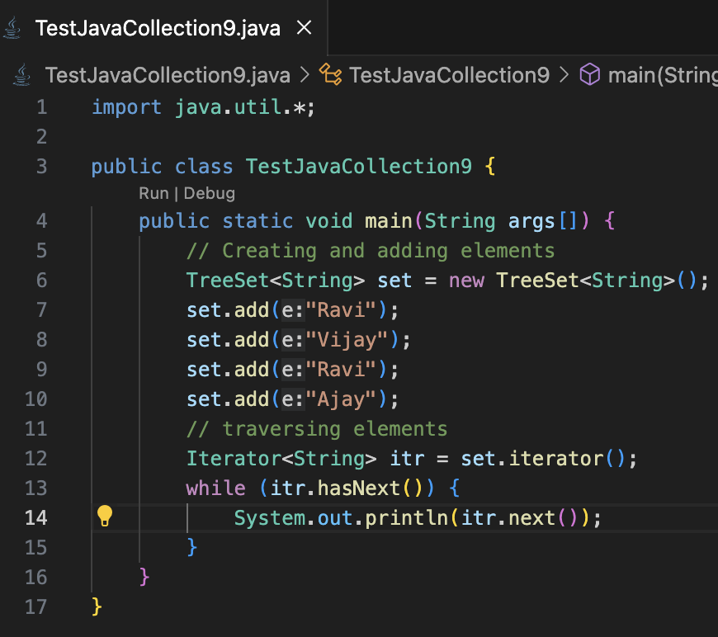
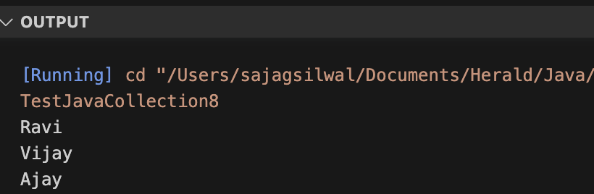
1. Introduction to Data Structure
1.1. types of data structures
1.2. Importance of Data Structure
2. Collection framework in Java
2.1.Introduction
2.2. Collection framework
2.3. Framework
2.4. Need for a Separate Collection Framework
2.5. All Collection Framework contain
2.5.1. Interfaces
2.5.2. Implementation
2.5.3. Algorithm
2.6. Java Collection Framework Hierarchy
2.7. Methods of Collection interface
3. Iterator Interface
4. Iterable Interface
5. Collection Interface
5.1. List Interface
5.2. ArrayList
5.2.1. ArrayList methods
5.3. LinkedList
5.3.1. LinkedList methods
5.4. ArrayList Vs LinkedList
5.6. Stack
6. Queue Interface
6.1. Priority Queue
6.2. Deque Interface
6.3. ArrayDeque
7. Set Interface
7.1. HashSet
7.2. LinkedHashSet
7.3. SortedSet Interface
7.4. TreeSet
8. Java Map Interface
8.1. HashMap
8.1.1 Hashmap declaration in Java
8.1.2 Java Hashmap Example
8.2. Linked HashMap Interface
8.2.1. Linked HashMap declaration in Java
8.2.2. Java Linked HashMap Example
8.3. Java TreeMap Class
8.3.1. TreeMap declaration in Java
9. Collection Sort in Java
10. Binary Search in Java
10.1. Implementation of Binary Search
11. Stack
11.1 Stack Class Java
11.2 Initialization of stack in Java
11.3 Methods of Stack class
12 CRUD operation in ArrayList
12.1. Adding to an ArrayList
12.2. Updating in an ArrayList
12.3. Deleting from an ArrayList
13. Data Access Object(DAO) Pattern
13.1. Implementation of DAO
TreeSet
Java TreeSet class implements the Set interface that uses a tree for storage. Like HashSet, TreeSet also contains unique elements.
However, the access and retrieval time of TreeSet is quite fast. The elements in TreeSet stored in ascending order.

Slide 47
1. Introduction to Data Structure
1.1. types of data structures
1.2. Importance of Data Structure
2. Collection framework in Java
2.1.Introduction
2.2. Collection framework
2.3. Framework
2.4. Need for a Separate Collection Framework
2.5. All Collection Framework contain
2.5.1. Interfaces
2.5.2. Implementation
2.5.3. Algorithm
2.6. Java Collection Framework Hierarchy
2.7. Methods of Collection interface
3. Iterator Interface
4. Iterable Interface
5. Collection Interface
5.1. List Interface
5.2. ArrayList
5.2.1. ArrayList methods
5.3. LinkedList
5.3.1. LinkedList methods
5.4. ArrayList Vs LinkedList
5.6. Stack
6. Queue Interface
6.1. Priority Queue
6.2. Deque Interface
6.3. ArrayDeque
7. Set Interface
7.1. HashSet
7.2. LinkedHashSet
7.3. SortedSet Interface
7.4. TreeSet
8. Java Map Interface
8.1. HashMap
8.1.1 Hashmap declaration in Java
8.1.2 Java Hashmap Example
8.2. Linked HashMap Interface
8.2.1. Linked HashMap declaration in Java
8.2.2. Java Linked HashMap Example
8.3. Java TreeMap Class
8.3.1. TreeMap declaration in Java
9. Collection Sort in Java
10. Binary Search in Java
10.1. Implementation of Binary Search
11. Stack
11.1 Stack Class Java
11.2 Initialization of stack in Java
11.3 Methods of Stack class
12 CRUD operation in ArrayList
12.1. Adding to an ArrayList
12.2. Updating in an ArrayList
12.3. Deleting from an ArrayList
13. Data Access Object(DAO) Pattern
13.1. Implementation of DAO
Java Map Interface
A map contains values on the basis of key, i.e. key and value pair. Each key and value pair is known as an entry. A Map contains unique keys.
A Map is useful if you have to search, update or delete elements on the basis of a key.
A Map doesn't allow duplicate keys, but you can have duplicate values. HashMap and LinkedHashMap allow null keys and values, but TreeMap doesn't allow any null key or value.

Slide 48
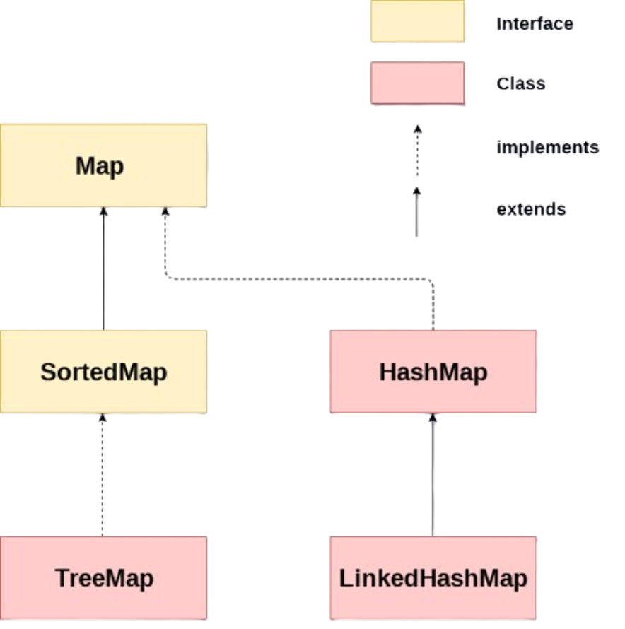
1. Introduction to Data Structure
1.1. types of data structures
1.2. Importance of Data Structure
2. Collection framework in Java
2.1.Introduction
2.2. Collection framework
2.3. Framework
2.4. Need for a Separate Collection Framework
2.5. All Collection Framework contain
2.5.1. Interfaces
2.5.2. Implementation
2.5.3. Algorithm
2.6. Java Collection Framework Hierarchy
2.7. Methods of Collection interface
3. Iterator Interface
4. Iterable Interface
5. Collection Interface
5.1. List Interface
5.2. ArrayList
5.2.1. ArrayList methods
5.3. LinkedList
5.3.1. LinkedList methods
5.4. ArrayList Vs LinkedList
5.6. Stack
6. Queue Interface
6.1. Priority Queue
6.2. Deque Interface
6.3. ArrayDeque
7. Set Interface
7.1. HashSet
7.2. LinkedHashSet
7.3. SortedSet Interface
7.4. TreeSet
8. Java Map Interface
8.1. HashMap
8.1.1 Hashmap declaration in Java
8.1.2 Java Hashmap Example
8.2. Linked HashMap Interface
8.2.1. Linked HashMap declaration in Java
8.2.2. Java Linked HashMap Example
8.3. Java TreeMap Class
8.3.1. TreeMap declaration in Java
9. Collection Sort in Java
10. Binary Search in Java
10.1. Implementation of Binary Search
11. Stack
11.1 Stack Class Java
11.2 Initialization of stack in Java
11.3 Methods of Stack class
12 CRUD operation in ArrayList
12.1. Adding to an ArrayList
12.2. Updating in an ArrayList
12.3. Deleting from an ArrayList
13. Data Access Object(DAO) Pattern
13.1. Implementation of DAO
Java Map Interface hierarchy
There are two interfaces for implementing Map in java: Map and SortedMap, and three classes: HashMap, LinkedHashMap, and TreeMap. The hierarchy of Java Map is given below:

Slide 49
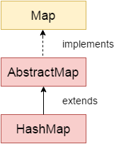
1. Introduction to Data Structure
1.1. types of data structures
1.2. Importance of Data Structure
2. Collection framework in Java
2.1.Introduction
2.2. Collection framework
2.3. Framework
2.4. Need for a Separate Collection Framework
2.5. All Collection Framework contain
2.5.1. Interfaces
2.5.2. Implementation
2.5.3. Algorithm
2.6. Java Collection Framework Hierarchy
2.7. Methods of Collection interface
3. Iterator Interface
4. Iterable Interface
5. Collection Interface
5.1. List Interface
5.2. ArrayList
5.2.1. ArrayList methods
5.3. LinkedList
5.3.1. LinkedList methods
5.4. ArrayList Vs LinkedList
5.6. Stack
6. Queue Interface
6.1. Priority Queue
6.2. Deque Interface
6.3. ArrayDeque
7. Set Interface
7.1. HashSet
7.2. LinkedHashSet
7.3. SortedSet Interface
7.4. TreeSet
8. Java Map Interface
8.1. HashMap
8.1.1 Hashmap declaration in Java
8.1.2 Java Hashmap Example
8.2. Linked HashMap Interface
8.2.1. Linked HashMap declaration in Java
8.2.2. Java Linked HashMap Example
8.3. Java TreeMap Class
8.3.1. TreeMap declaration in Java
9. Collection Sort in Java
10. Binary Search in Java
10.1. Implementation of Binary Search
11. Stack
11.1 Stack Class Java
11.2 Initialization of stack in Java
11.3 Methods of Stack class
12 CRUD operation in ArrayList
12.1. Adding to an ArrayList
12.2. Updating in an ArrayList
12.3. Deleting from an ArrayList
13. Data Access Object(DAO) Pattern
13.1. Implementation of DAO
HashMap
Java HashMap class implements the Map interface which allows us to store key and value pair, where keys should be unique.
If you try to insert the duplicate key, it will replace the element of the corresponding key.
It is easy to perform operations using the key index like updation, deletion, etc. HashMap class is found in the java.util package.

Slide 50
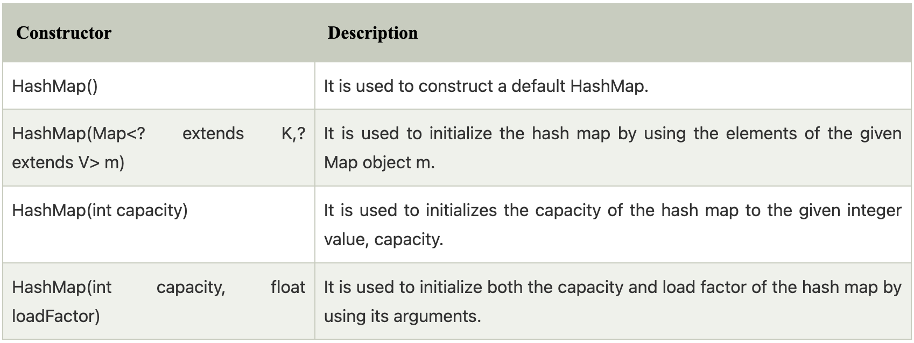
1. Introduction to Data Structure
1.1. types of data structures
1.2. Importance of Data Structure
2. Collection framework in Java
2.1.Introduction
2.2. Collection framework
2.3. Framework
2.4. Need for a Separate Collection Framework
2.5. All Collection Framework contain
2.5.1. Interfaces
2.5.2. Implementation
2.5.3. Algorithm
2.6. Java Collection Framework Hierarchy
2.7. Methods of Collection interface
3. Iterator Interface
4. Iterable Interface
5. Collection Interface
5.1. List Interface
5.2. ArrayList
5.2.1. ArrayList methods
5.3. LinkedList
5.3.1. LinkedList methods
5.4. ArrayList Vs LinkedList
5.6. Stack
6. Queue Interface
6.1. Priority Queue
6.2. Deque Interface
6.3. ArrayDeque
7. Set Interface
7.1. HashSet
7.2. LinkedHashSet
7.3. SortedSet Interface
7.4. TreeSet
8. Java Map Interface
8.1. HashMap
8.1.1 Hashmap declaration in Java
8.1.2 Java Hashmap Example
8.2. Linked HashMap Interface
8.2.1. Linked HashMap declaration in Java
8.2.2. Java Linked HashMap Example
8.3. Java TreeMap Class
8.3.1. TreeMap declaration in Java
9. Collection Sort in Java
10. Binary Search in Java
10.1. Implementation of Binary Search
11. Stack
11.1 Stack Class Java
11.2 Initialization of stack in Java
11.3 Methods of Stack class
12 CRUD operation in ArrayList
12.1. Adding to an ArrayList
12.2. Updating in an ArrayList
12.3. Deleting from an ArrayList
13. Data Access Object(DAO) Pattern
13.1. Implementation of DAO
Hashmap declaration in Java
To declare hashmap you must import, java.util.HashMap class.
Constructor of Hashmap class

Slide 51
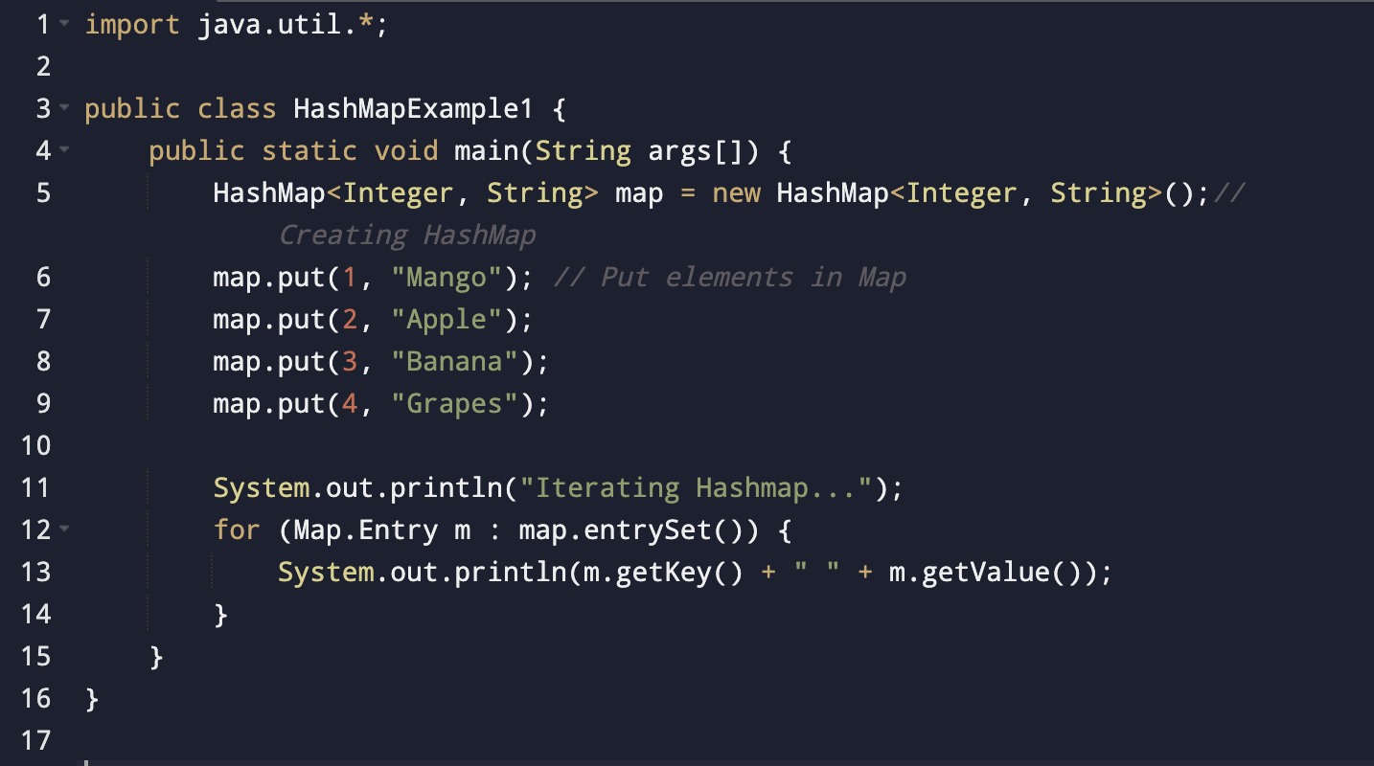
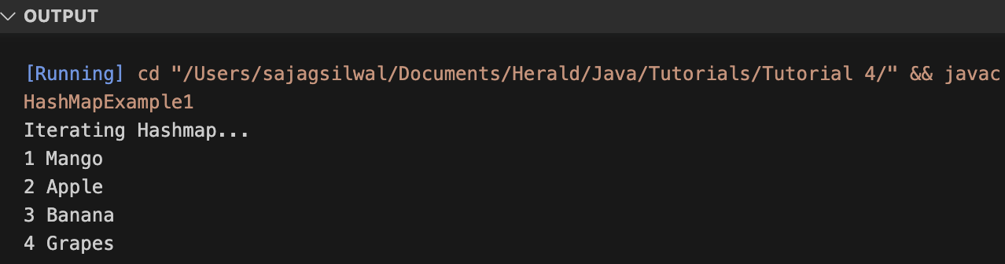
1. Introduction to Data Structure
1.1. types of data structures
1.2. Importance of Data Structure
2. Collection framework in Java
2.1.Introduction
2.2. Collection framework
2.3. Framework
2.4. Need for a Separate Collection Framework
2.5. All Collection Framework contain
2.5.1. Interfaces
2.5.2. Implementation
2.5.3. Algorithm
2.6. Java Collection Framework Hierarchy
2.7. Methods of Collection interface
3. Iterator Interface
4. Iterable Interface
5. Collection Interface
5.1. List Interface
5.2. ArrayList
5.2.1. ArrayList methods
5.3. LinkedList
5.3.1. LinkedList methods
5.4. ArrayList Vs LinkedList
5.6. Stack
6. Queue Interface
6.1. Priority Queue
6.2. Deque Interface
6.3. ArrayDeque
7. Set Interface
7.1. HashSet
7.2. LinkedHashSet
7.3. SortedSet Interface
7.4. TreeSet
8. Java Map Interface
8.1. HashMap
8.1.1 Hashmap declaration in Java
8.1.2 Java Hashmap Example
8.2. Linked HashMap Interface
8.2.1. Linked HashMap declaration in Java
8.2.2. Java Linked HashMap Example
8.3. Java TreeMap Class
8.3.1. TreeMap declaration in Java
9. Collection Sort in Java
10. Binary Search in Java
10.1. Implementation of Binary Search
11. Stack
11.1 Stack Class Java
11.2 Initialization of stack in Java
11.3 Methods of Stack class
12 CRUD operation in ArrayList
12.1. Adding to an ArrayList
12.2. Updating in an ArrayList
12.3. Deleting from an ArrayList
13. Data Access Object(DAO) Pattern
13.1. Implementation of DAO
Java Hashmap Example

Slide 52
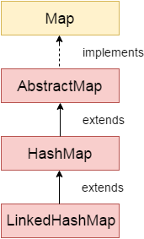
1. Introduction to Data Structure
1.1. types of data structures
1.2. Importance of Data Structure
2. Collection framework in Java
2.1.Introduction
2.2. Collection framework
2.3. Framework
2.4. Need for a Separate Collection Framework
2.5. All Collection Framework contain
2.5.1. Interfaces
2.5.2. Implementation
2.5.3. Algorithm
2.6. Java Collection Framework Hierarchy
2.7. Methods of Collection interface
3. Iterator Interface
4. Iterable Interface
5. Collection Interface
5.1. List Interface
5.2. ArrayList
5.2.1. ArrayList methods
5.3. LinkedList
5.3.1. LinkedList methods
5.4. ArrayList Vs LinkedList
5.6. Stack
6. Queue Interface
6.1. Priority Queue
6.2. Deque Interface
6.3. ArrayDeque
7. Set Interface
7.1. HashSet
7.2. LinkedHashSet
7.3. SortedSet Interface
7.4. TreeSet
8. Java Map Interface
8.1. HashMap
8.1.1 Hashmap declaration in Java
8.1.2 Java Hashmap Example
8.2. Linked HashMap Interface
8.2.1. Linked HashMap declaration in Java
8.2.2. Java Linked HashMap Example
8.3. Java TreeMap Class
8.3.1. TreeMap declaration in Java
9. Collection Sort in Java
10. Binary Search in Java
10.1. Implementation of Binary Search
11. Stack
11.1 Stack Class Java
11.2 Initialization of stack in Java
11.3 Methods of Stack class
12 CRUD operation in ArrayList
12.1. Adding to an ArrayList
12.2. Updating in an ArrayList
12.3. Deleting from an ArrayList
13. Data Access Object(DAO) Pattern
13.1. Implementation of DAO
Linked HashMap Interface
Java LinkedHashMap contains values based on the key.
Java LinkedHashMap contains unique elements.
Java LinkedHashMap may have one null key and multiple null values.
Java LinkedHashMap is non synchronized.
Java LinkedHashMap maintains insertion order.
The initial default capacity of Java HashMap class is 16 with a load factor of 0.75.

Slide 53
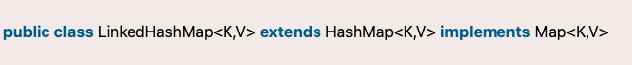
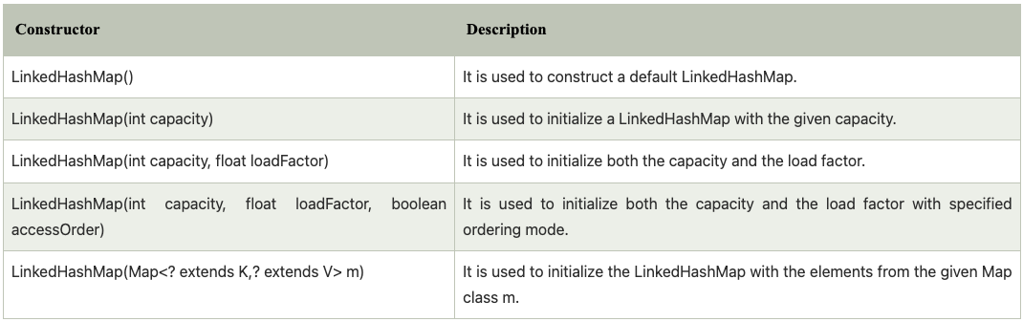
1. Introduction to Data Structure
1.1. types of data structures
1.2. Importance of Data Structure
2. Collection framework in Java
2.1.Introduction
2.2. Collection framework
2.3. Framework
2.4. Need for a Separate Collection Framework
2.5. All Collection Framework contain
2.5.1. Interfaces
2.5.2. Implementation
2.5.3. Algorithm
2.6. Java Collection Framework Hierarchy
2.7. Methods of Collection interface
3. Iterator Interface
4. Iterable Interface
5. Collection Interface
5.1. List Interface
5.2. ArrayList
5.2.1. ArrayList methods
5.3. LinkedList
5.3.1. LinkedList methods
5.4. ArrayList Vs LinkedList
5.6. Stack
6. Queue Interface
6.1. Priority Queue
6.2. Deque Interface
6.3. ArrayDeque
7. Set Interface
7.1. HashSet
7.2. LinkedHashSet
7.3. SortedSet Interface
7.4. TreeSet
8. Java Map Interface
8.1. HashMap
8.1.1 Hashmap declaration in Java
8.1.2 Java Hashmap Example
8.2. Linked HashMap Interface
8.2.1. Linked HashMap declaration in Java
8.2.2. Java Linked HashMap Example
8.3. Java TreeMap Class
8.3.1. TreeMap declaration in Java
9. Collection Sort in Java
10. Binary Search in Java
10.1. Implementation of Binary Search
11. Stack
11.1 Stack Class Java
11.2 Initialization of stack in Java
11.3 Methods of Stack class
12 CRUD operation in ArrayList
12.1. Adding to an ArrayList
12.2. Updating in an ArrayList
12.3. Deleting from an ArrayList
13. Data Access Object(DAO) Pattern
13.1. Implementation of DAO
Linked HashMap declaration in Java
To declare linkedhashmap you must import, java.util.HashMap class.
Constructor of Linked Hashmap class

Slide 54
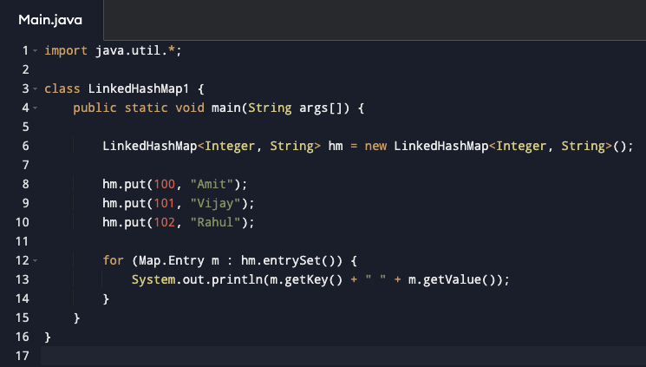
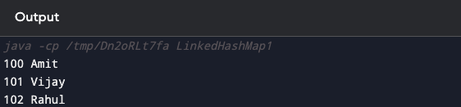
1. Introduction to Data Structure
1.1. types of data structures
1.2. Importance of Data Structure
2. Collection framework in Java
2.1.Introduction
2.2. Collection framework
2.3. Framework
2.4. Need for a Separate Collection Framework
2.5. All Collection Framework contain
2.5.1. Interfaces
2.5.2. Implementation
2.5.3. Algorithm
2.6. Java Collection Framework Hierarchy
2.7. Methods of Collection interface
3. Iterator Interface
4. Iterable Interface
5. Collection Interface
5.1. List Interface
5.2. ArrayList
5.2.1. ArrayList methods
5.3. LinkedList
5.3.1. LinkedList methods
5.4. ArrayList Vs LinkedList
5.6. Stack
6. Queue Interface
6.1. Priority Queue
6.2. Deque Interface
6.3. ArrayDeque
7. Set Interface
7.1. HashSet
7.2. LinkedHashSet
7.3. SortedSet Interface
7.4. TreeSet
8. Java Map Interface
8.1. HashMap
8.1.1 Hashmap declaration in Java
8.1.2 Java Hashmap Example
8.2. Linked HashMap Interface
8.2.1. Linked HashMap declaration in Java
8.2.2. Java Linked HashMap Example
8.3. Java TreeMap Class
8.3.1. TreeMap declaration in Java
9. Collection Sort in Java
10. Binary Search in Java
10.1. Implementation of Binary Search
11. Stack
11.1 Stack Class Java
11.2 Initialization of stack in Java
11.3 Methods of Stack class
12 CRUD operation in ArrayList
12.1. Adding to an ArrayList
12.2. Updating in an ArrayList
12.3. Deleting from an ArrayList
13. Data Access Object(DAO) Pattern
13.1. Implementation of DAO
Java Linked HashMap Example

Slide 55
1. Introduction to Data Structure
1.1. types of data structures
1.2. Importance of Data Structure
2. Collection framework in Java
2.1.Introduction
2.2. Collection framework
2.3. Framework
2.4. Need for a Separate Collection Framework
2.5. All Collection Framework contain
2.5.1. Interfaces
2.5.2. Implementation
2.5.3. Algorithm
2.6. Java Collection Framework Hierarchy
2.7. Methods of Collection interface
3. Iterator Interface
4. Iterable Interface
5. Collection Interface
5.1. List Interface
5.2. ArrayList
5.2.1. ArrayList methods
5.3. LinkedList
5.3.1. LinkedList methods
5.4. ArrayList Vs LinkedList
5.6. Stack
6. Queue Interface
6.1. Priority Queue
6.2. Deque Interface
6.3. ArrayDeque
7. Set Interface
7.1. HashSet
7.2. LinkedHashSet
7.3. SortedSet Interface
7.4. TreeSet
8. Java Map Interface
8.1. HashMap
8.1.1 Hashmap declaration in Java
8.1.2 Java Hashmap Example
8.2. Linked HashMap Interface
8.2.1. Linked HashMap declaration in Java
8.2.2. Java Linked HashMap Example
8.3. Java TreeMap Class
8.3.1. TreeMap declaration in Java
9. Collection Sort in Java
10. Binary Search in Java
10.1. Implementation of Binary Search
11. Stack
11.1 Stack Class Java
11.2 Initialization of stack in Java
11.3 Methods of Stack class
12 CRUD operation in ArrayList
12.1. Adding to an ArrayList
12.2. Updating in an ArrayList
12.3. Deleting from an ArrayList
13. Data Access Object(DAO) Pattern
13.1. Implementation of DAO
Java TreeMap Class
Java TreeMap class is a red-black tree based implementation. It provides an efficient means of storing key-value pairs in sorted order.
Java TreeMap contains values based on the key.
It implements the NavigableMap interface and extends AbstractMap class.
Java TreeMap contains only unique elements.
Java TreeMap cannot have a null key but can have multiple null values.
Java TreeMap is non synchronized.
Java TreeMap maintains ascending order.

Slide 56
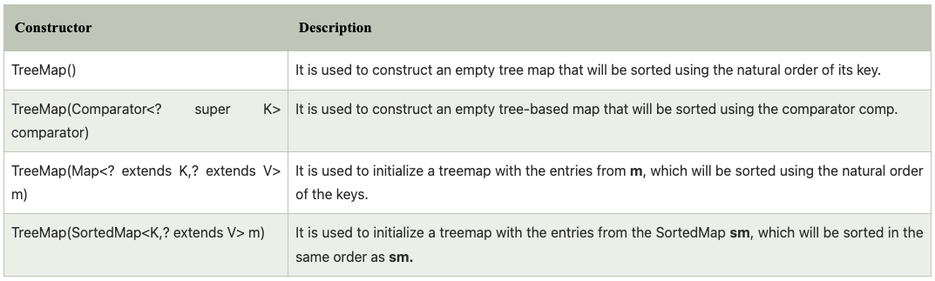
1. Introduction to Data Structure
1.1. types of data structures
1.2. Importance of Data Structure
2. Collection framework in Java
2.1.Introduction
2.2. Collection framework
2.3. Framework
2.4. Need for a Separate Collection Framework
2.5. All Collection Framework contain
2.5.1. Interfaces
2.5.2. Implementation
2.5.3. Algorithm
2.6. Java Collection Framework Hierarchy
2.7. Methods of Collection interface
3. Iterator Interface
4. Iterable Interface
5. Collection Interface
5.1. List Interface
5.2. ArrayList
5.2.1. ArrayList methods
5.3. LinkedList
5.3.1. LinkedList methods
5.4. ArrayList Vs LinkedList
5.6. Stack
6. Queue Interface
6.1. Priority Queue
6.2. Deque Interface
6.3. ArrayDeque
7. Set Interface
7.1. HashSet
7.2. LinkedHashSet
7.3. SortedSet Interface
7.4. TreeSet
8. Java Map Interface
8.1. HashMap
8.1.1 Hashmap declaration in Java
8.1.2 Java Hashmap Example
8.2. Linked HashMap Interface
8.2.1. Linked HashMap declaration in Java
8.2.2. Java Linked HashMap Example
8.3. Java TreeMap Class
8.3.1. TreeMap declaration in Java
9. Collection Sort in Java
10. Binary Search in Java
10.1. Implementation of Binary Search
11. Stack
11.1 Stack Class Java
11.2 Initialization of stack in Java
11.3 Methods of Stack class
12 CRUD operation in ArrayList
12.1. Adding to an ArrayList
12.2. Updating in an ArrayList
12.3. Deleting from an ArrayList
13. Data Access Object(DAO) Pattern
13.1. Implementation of DAO
TreeMap declaration in Java
To declare linkedhashmap you must import, java.util.HashMap class.
Constructor of TreeMap class

Slide 57
1. Introduction to Data Structure
1.1. types of data structures
1.2. Importance of Data Structure
2. Collection framework in Java
2.1.Introduction
2.2. Collection framework
2.3. Framework
2.4. Need for a Separate Collection Framework
2.5. All Collection Framework contain
2.5.1. Interfaces
2.5.2. Implementation
2.5.3. Algorithm
2.6. Java Collection Framework Hierarchy
2.7. Methods of Collection interface
3. Iterator Interface
4. Iterable Interface
5. Collection Interface
5.1. List Interface
5.2. ArrayList
5.2.1. ArrayList methods
5.3. LinkedList
5.3.1. LinkedList methods
5.4. ArrayList Vs LinkedList
5.6. Stack
6. Queue Interface
6.1. Priority Queue
6.2. Deque Interface
6.3. ArrayDeque
7. Set Interface
7.1. HashSet
7.2. LinkedHashSet
7.3. SortedSet Interface
7.4. TreeSet
8. Java Map Interface
8.1. HashMap
8.1.1 Hashmap declaration in Java
8.1.2 Java Hashmap Example
8.2. Linked HashMap Interface
8.2.1. Linked HashMap declaration in Java
8.2.2. Java Linked HashMap Example
8.3. Java TreeMap Class
8.3.1. TreeMap declaration in Java
9. Collection Sort in Java
10. Binary Search in Java
10.1. Implementation of Binary Search
11. Stack
11.1 Stack Class Java
11.2 Initialization of stack in Java
11.3 Methods of Stack class
12 CRUD operation in ArrayList
12.1. Adding to an ArrayList
12.2. Updating in an ArrayList
12.3. Deleting from an ArrayList
13. Data Access Object(DAO) Pattern
13.1. Implementation of DAO
Collections Sort in Java
Collections sort is a method of Java Collections class used to sort a list, which implements the List interface.
All the elements in the list must be mutually comparable.
Implementation of the Collections Sort Method in Java
The Collections.sort has two overloaded methods :
public static void sort(List list)
Sort the list into ascending order, the natural ordering of its element.
public static void sort(List list, Comparator c)
Sort the list according to the specified comparator.

Slide 58
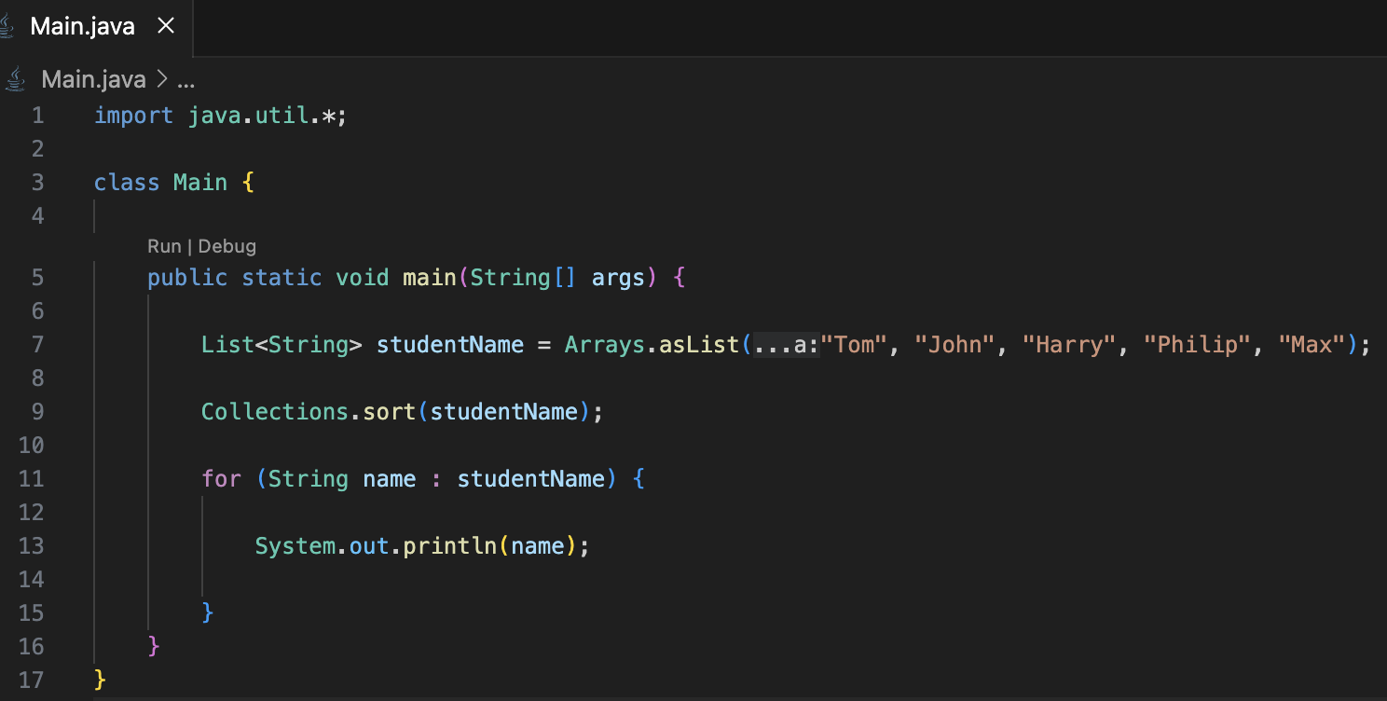
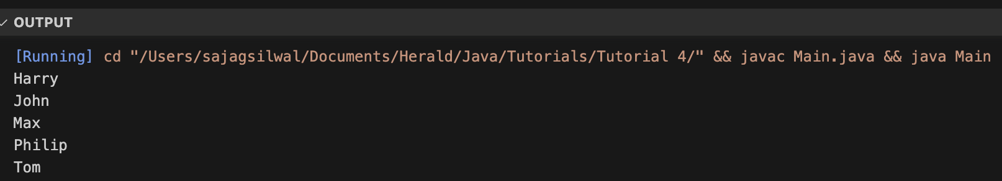
1. Introduction to Data Structure
1.1. types of data structures
1.2. Importance of Data Structure
2. Collection framework in Java
2.1.Introduction
2.2. Collection framework
2.3. Framework
2.4. Need for a Separate Collection Framework
2.5. All Collection Framework contain
2.5.1. Interfaces
2.5.2. Implementation
2.5.3. Algorithm
2.6. Java Collection Framework Hierarchy
2.7. Methods of Collection interface
3. Iterator Interface
4. Iterable Interface
5. Collection Interface
5.1. List Interface
5.2. ArrayList
5.2.1. ArrayList methods
5.3. LinkedList
5.3.1. LinkedList methods
5.4. ArrayList Vs LinkedList
5.6. Stack
6. Queue Interface
6.1. Priority Queue
6.2. Deque Interface
6.3. ArrayDeque
7. Set Interface
7.1. HashSet
7.2. LinkedHashSet
7.3. SortedSet Interface
7.4. TreeSet
8. Java Map Interface
8.1. HashMap
8.1.1 Hashmap declaration in Java
8.1.2 Java Hashmap Example
8.2. Linked HashMap Interface
8.2.1. Linked HashMap declaration in Java
8.2.2. Java Linked HashMap Example
8.3. Java TreeMap Class
8.3.1. TreeMap declaration in Java
9. Collection Sort in Java
10. Binary Search in Java
10.1. Implementation of Binary Search
11. Stack
11.1 Stack Class Java
11.2 Initialization of stack in Java
11.3 Methods of Stack class
12 CRUD operation in ArrayList
12.1. Adding to an ArrayList
12.2. Updating in an ArrayList
12.3. Deleting from an ArrayList
13. Data Access Object(DAO) Pattern
13.1. Implementation of DAO
public static void sort(List list)

Slide 59
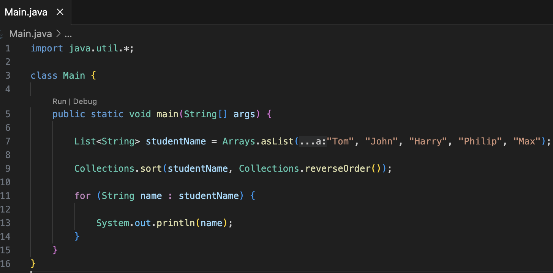
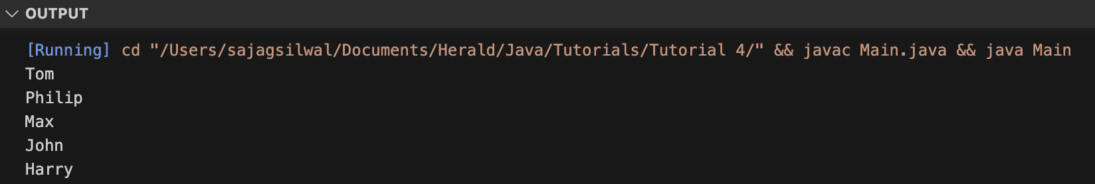
1. Introduction to Data Structure
1.1. types of data structures
1.2. Importance of Data Structure
2. Collection framework in Java
2.1.Introduction
2.2. Collection framework
2.3. Framework
2.4. Need for a Separate Collection Framework
2.5. All Collection Framework contain
2.5.1. Interfaces
2.5.2. Implementation
2.5.3. Algorithm
2.6. Java Collection Framework Hierarchy
2.7. Methods of Collection interface
3. Iterator Interface
4. Iterable Interface
5. Collection Interface
5.1. List Interface
5.2. ArrayList
5.2.1. ArrayList methods
5.3. LinkedList
5.3.1. LinkedList methods
5.4. ArrayList Vs LinkedList
5.6. Stack
6. Queue Interface
6.1. Priority Queue
6.2. Deque Interface
6.3. ArrayDeque
7. Set Interface
7.1. HashSet
7.2. LinkedHashSet
7.3. SortedSet Interface
7.4. TreeSet
8. Java Map Interface
8.1. HashMap
8.1.1 Hashmap declaration in Java
8.1.2 Java Hashmap Example
8.2. Linked HashMap Interface
8.2.1. Linked HashMap declaration in Java
8.2.2. Java Linked HashMap Example
8.3. Java TreeMap Class
8.3.1. TreeMap declaration in Java
9. Collection Sort in Java
10. Binary Search in Java
10.1. Implementation of Binary Search
11. Stack
11.1 Stack Class Java
11.2 Initialization of stack in Java
11.3 Methods of Stack class
12 CRUD operation in ArrayList
12.1. Adding to an ArrayList
12.2. Updating in an ArrayList
12.3. Deleting from an ArrayList
13. Data Access Object(DAO) Pattern
13.1. Implementation of DAO
public static void sort(List list)
We can also sort the student names in descending order using Collections.reverseOrder().

Slide 60
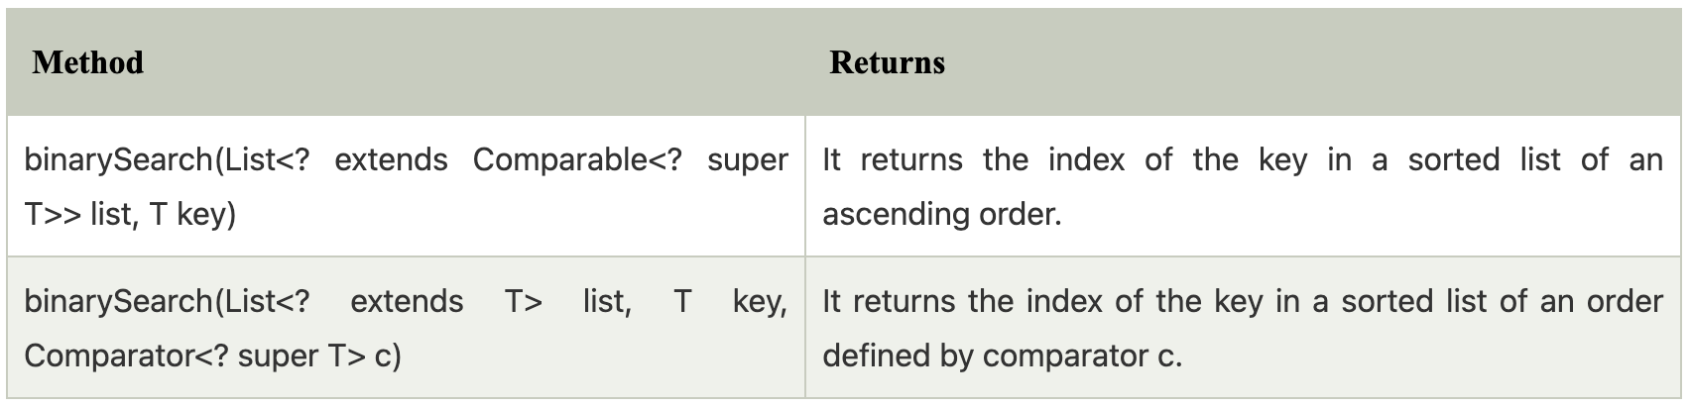
1. Introduction to Data Structure
1.1. types of data structures
1.2. Importance of Data Structure
2. Collection framework in Java
2.1.Introduction
2.2. Collection framework
2.3. Framework
2.4. Need for a Separate Collection Framework
2.5. All Collection Framework contain
2.5.1. Interfaces
2.5.2. Implementation
2.5.3. Algorithm
2.6. Java Collection Framework Hierarchy
2.7. Methods of Collection interface
3. Iterator Interface
4. Iterable Interface
5. Collection Interface
5.1. List Interface
5.2. ArrayList
5.2.1. ArrayList methods
5.3. LinkedList
5.3.1. LinkedList methods
5.4. ArrayList Vs LinkedList
5.6. Stack
6. Queue Interface
6.1. Priority Queue
6.2. Deque Interface
6.3. ArrayDeque
7. Set Interface
7.1. HashSet
7.2. LinkedHashSet
7.3. SortedSet Interface
7.4. TreeSet
8. Java Map Interface
8.1. HashMap
8.1.1 Hashmap declaration in Java
8.1.2 Java Hashmap Example
8.2. Linked HashMap Interface
8.2.1. Linked HashMap declaration in Java
8.2.2. Java Linked HashMap Example
8.3. Java TreeMap Class
8.3.1. TreeMap declaration in Java
9. Collection Sort in Java
10. Binary Search in Java
10.1. Implementation of Binary Search
11. Stack
11.1 Stack Class Java
11.2 Initialization of stack in Java
11.3 Methods of Stack class
12 CRUD operation in ArrayList
12.1. Adding to an ArrayList
12.2. Updating in an ArrayList
12.3. Deleting from an ArrayList
13. Data Access Object(DAO) Pattern
13.1. Implementation of DAO
Binary Search in Java
The binarySearch() is an inbuilt method of Java Collections class which returns the position of the object in a sorted list. There are two different types of Java collections binarySearch() method which can be differentiated depending on its parameter.

Slide 61
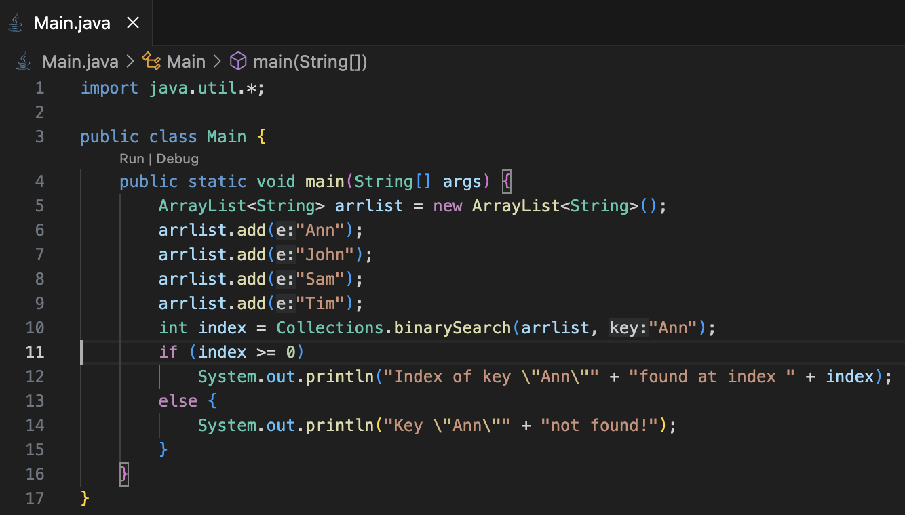

1. Introduction to Data Structure
1.1. types of data structures
1.2. Importance of Data Structure
2. Collection framework in Java
2.1.Introduction
2.2. Collection framework
2.3. Framework
2.4. Need for a Separate Collection Framework
2.5. All Collection Framework contain
2.5.1. Interfaces
2.5.2. Implementation
2.5.3. Algorithm
2.6. Java Collection Framework Hierarchy
2.7. Methods of Collection interface
3. Iterator Interface
4. Iterable Interface
5. Collection Interface
5.1. List Interface
5.2. ArrayList
5.2.1. ArrayList methods
5.3. LinkedList
5.3.1. LinkedList methods
5.4. ArrayList Vs LinkedList
5.6. Stack
6. Queue Interface
6.1. Priority Queue
6.2. Deque Interface
6.3. ArrayDeque
7. Set Interface
7.1. HashSet
7.2. LinkedHashSet
7.3. SortedSet Interface
7.4. TreeSet
8. Java Map Interface
8.1. HashMap
8.1.1 Hashmap declaration in Java
8.1.2 Java Hashmap Example
8.2. Linked HashMap Interface
8.2.1. Linked HashMap declaration in Java
8.2.2. Java Linked HashMap Example
8.3. Java TreeMap Class
8.3.1. TreeMap declaration in Java
9. Collection Sort in Java
10. Binary Search in Java
10.1. Implementation of Binary Search
11. Stack
11.1 Stack Class Java
11.2 Initialization of stack in Java
11.3 Methods of Stack class
12 CRUD operation in ArrayList
12.1. Adding to an ArrayList
12.2. Updating in an ArrayList
12.3. Deleting from an ArrayList
13. Data Access Object(DAO) Pattern
13.1. Implementation of DAO
Implementation of Binary Search

Slide 62

1. Introduction to Data Structure
1.1. types of data structures
1.2. Importance of Data Structure
2. Collection framework in Java
2.1.Introduction
2.2. Collection framework
2.3. Framework
2.4. Need for a Separate Collection Framework
2.5. All Collection Framework contain
2.5.1. Interfaces
2.5.2. Implementation
2.5.3. Algorithm
2.6. Java Collection Framework Hierarchy
2.7. Methods of Collection interface
3. Iterator Interface
4. Iterable Interface
5. Collection Interface
5.1. List Interface
5.2. ArrayList
5.2.1. ArrayList methods
5.3. LinkedList
5.3.1. LinkedList methods
5.4. ArrayList Vs LinkedList
5.6. Stack
6. Queue Interface
6.1. Priority Queue
6.2. Deque Interface
6.3. ArrayDeque
7. Set Interface
7.1. HashSet
7.2. LinkedHashSet
7.3. SortedSet Interface
7.4. TreeSet
8. Java Map Interface
8.1. HashMap
8.1.1 Hashmap declaration in Java
8.1.2 Java Hashmap Example
8.2. Linked HashMap Interface
8.2.1. Linked HashMap declaration in Java
8.2.2. Java Linked HashMap Example
8.3. Java TreeMap Class
8.3.1. TreeMap declaration in Java
9. Collection Sort in Java
10. Binary Search in Java
10.1. Implementation of Binary Search
11. Stack
11.1 Stack Class Java
11.2 Initialization of stack in Java
11.3 Methods of Stack class
12 CRUD operation in ArrayList
12.1. Adding to an ArrayList
12.2. Updating in an ArrayList
12.3. Deleting from an ArrayList
13. Data Access Object(DAO) Pattern
13.1. Implementation of DAO
Stack
The stack is a linear data structure that is used to store the collection of objects. It is based on Last-In-First-Out (LIFO) or First-In-Last-Out(FILO).
This means the last element inserted inside the stack is removed first.

Slide 63

1. Introduction to Data Structure
1.1. types of data structures
1.2. Importance of Data Structure
2. Collection framework in Java
2.1.Introduction
2.2. Collection framework
2.3. Framework
2.4. Need for a Separate Collection Framework
2.5. All Collection Framework contain
2.5.1. Interfaces
2.5.2. Implementation
2.5.3. Algorithm
2.6. Java Collection Framework Hierarchy
2.7. Methods of Collection interface
3. Iterator Interface
4. Iterable Interface
5. Collection Interface
5.1. List Interface
5.2. ArrayList
5.2.1. ArrayList methods
5.3. LinkedList
5.3.1. LinkedList methods
5.4. ArrayList Vs LinkedList
5.6. Stack
6. Queue Interface
6.1. Priority Queue
6.2. Deque Interface
6.3. ArrayDeque
7. Set Interface
7.1. HashSet
7.2. LinkedHashSet
7.3. SortedSet Interface
7.4. TreeSet
8. Java Map Interface
8.1. HashMap
8.1.1 Hashmap declaration in Java
8.1.2 Java Hashmap Example
8.2. Linked HashMap Interface
8.2.1. Linked HashMap declaration in Java
8.2.2. Java Linked HashMap Example
8.3. Java TreeMap Class
8.3.1. TreeMap declaration in Java
9. Collection Sort in Java
10. Binary Search in Java
10.1. Implementation of Binary Search
11. Stack
11.1 Stack Class Java
11.2 Initialization of stack in Java
11.3 Methods of Stack class
12 CRUD operation in ArrayList
12.1. Adding to an ArrayList
12.2. Updating in an ArrayList
12.3. Deleting from an ArrayList
13. Data Access Object(DAO) Pattern
13.1. Implementation of DAO
Stack Class Java
In Java, Stack is a class that falls under the Collection framework that extends the Vector class.
It also implements interfaces List, Collection, Iterable, Cloneable, Serializable.
Before using the Stack class, we must import the java.util package.

Slide 64


1. Introduction to Data Structure
1.1. types of data structures
1.2. Importance of Data Structure
2. Collection framework in Java
2.1.Introduction
2.2. Collection framework
2.3. Framework
2.4. Need for a Separate Collection Framework
2.5. All Collection Framework contain
2.5.1. Interfaces
2.5.2. Implementation
2.5.3. Algorithm
2.6. Java Collection Framework Hierarchy
2.7. Methods of Collection interface
3. Iterator Interface
4. Iterable Interface
5. Collection Interface
5.1. List Interface
5.2. ArrayList
5.2.1. ArrayList methods
5.3. LinkedList
5.3.1. LinkedList methods
5.4. ArrayList Vs LinkedList
5.6. Stack
6. Queue Interface
6.1. Priority Queue
6.2. Deque Interface
6.3. ArrayDeque
7. Set Interface
7.1. HashSet
7.2. LinkedHashSet
7.3. SortedSet Interface
7.4. TreeSet
8. Java Map Interface
8.1. HashMap
8.1.1 Hashmap declaration in Java
8.1.2 Java Hashmap Example
8.2. Linked HashMap Interface
8.2.1. Linked HashMap declaration in Java
8.2.2. Java Linked HashMap Example
8.3. Java TreeMap Class
8.3.1. TreeMap declaration in Java
9. Collection Sort in Java
10. Binary Search in Java
10.1. Implementation of Binary Search
11. Stack
11.1 Stack Class Java
11.2 Initialization of stack in Java
11.3 Methods of Stack class
12 CRUD operation in ArrayList
12.1. Adding to an ArrayList
12.2. Updating in an ArrayList
12.3. Deleting from an ArrayList
13. Data Access Object(DAO) Pattern
13.1. Implementation of DAO
Initialization of stack in Java
The Stack class contains only the default constructor that creates an empty stack.
public Stack()
If we want to create a stack, first, import the java.util package and create an object of the Stack class.
or

Slide 65

1. Introduction to Data Structure
1.1. types of data structures
1.2. Importance of Data Structure
2. Collection framework in Java
2.1.Introduction
2.2. Collection framework
2.3. Framework
2.4. Need for a Separate Collection Framework
2.5. All Collection Framework contain
2.5.1. Interfaces
2.5.2. Implementation
2.5.3. Algorithm
2.6. Java Collection Framework Hierarchy
2.7. Methods of Collection interface
3. Iterator Interface
4. Iterable Interface
5. Collection Interface
5.1. List Interface
5.2. ArrayList
5.2.1. ArrayList methods
5.3. LinkedList
5.3.1. LinkedList methods
5.4. ArrayList Vs LinkedList
5.6. Stack
6. Queue Interface
6.1. Priority Queue
6.2. Deque Interface
6.3. ArrayDeque
7. Set Interface
7.1. HashSet
7.2. LinkedHashSet
7.3. SortedSet Interface
7.4. TreeSet
8. Java Map Interface
8.1. HashMap
8.1.1 Hashmap declaration in Java
8.1.2 Java Hashmap Example
8.2. Linked HashMap Interface
8.2.1. Linked HashMap declaration in Java
8.2.2. Java Linked HashMap Example
8.3. Java TreeMap Class
8.3.1. TreeMap declaration in Java
9. Collection Sort in Java
10. Binary Search in Java
10.1. Implementation of Binary Search
11. Stack
11.1 Stack Class Java
11.2 Initialization of stack in Java
11.3 Methods of Stack class
12 CRUD operation in ArrayList
12.1. Adding to an ArrayList
12.2. Updating in an ArrayList
12.3. Deleting from an ArrayList
13. Data Access Object(DAO) Pattern
13.1. Implementation of DAO
Methods of Stack class
The Java Stack class provides mainly five methods to perform these operations. Along with this, it also provides all the methods of the Java Vector class.

Slide 66
1. Introduction to Data Structure
1.1. types of data structures
1.2. Importance of Data Structure
2. Collection framework in Java
2.1.Introduction
2.2. Collection framework
2.3. Framework
2.4. Need for a Separate Collection Framework
2.5. All Collection Framework contain
2.5.1. Interfaces
2.5.2. Implementation
2.5.3. Algorithm
2.6. Java Collection Framework Hierarchy
2.7. Methods of Collection interface
3. Iterator Interface
4. Iterable Interface
5. Collection Interface
5.1. List Interface
5.2. ArrayList
5.2.1. ArrayList methods
5.3. LinkedList
5.3.1. LinkedList methods
5.4. ArrayList Vs LinkedList
5.6. Stack
6. Queue Interface
6.1. Priority Queue
6.2. Deque Interface
6.3. ArrayDeque
7. Set Interface
7.1. HashSet
7.2. LinkedHashSet
7.3. SortedSet Interface
7.4. TreeSet
8. Java Map Interface
8.1. HashMap
8.1.1 Hashmap declaration in Java
8.1.2 Java Hashmap Example
8.2. Linked HashMap Interface
8.2.1. Linked HashMap declaration in Java
8.2.2. Java Linked HashMap Example
8.3. Java TreeMap Class
8.3.1. TreeMap declaration in Java
9. Collection Sort in Java
10. Binary Search in Java
10.1. Implementation of Binary Search
11. Stack
11.1 Stack Class Java
11.2 Initialization of stack in Java
11.3 Methods of Stack class
12 CRUD operation in ArrayList
12.1. Adding to an ArrayList
12.2. Updating in an ArrayList
12.3. Deleting from an ArrayList
13. Data Access Object(DAO) Pattern
13.1. Implementation of DAO
CRUD operation in ArrayList
The ArrayList class comes with some predefined methods for CRUD(CREATE, READ, UPDATE, DELETE) implementation features.
Adding to ArrayList
Adding elements to an ArrayList is pretty straight forward. The add(E e) method, where E is the element we want to add allows to add element to an ArrayList.

Slide 67


1. Introduction to Data Structure
1.1. types of data structures
1.2. Importance of Data Structure
2. Collection framework in Java
2.1.Introduction
2.2. Collection framework
2.3. Framework
2.4. Need for a Separate Collection Framework
2.5. All Collection Framework contain
2.5.1. Interfaces
2.5.2. Implementation
2.5.3. Algorithm
2.6. Java Collection Framework Hierarchy
2.7. Methods of Collection interface
3. Iterator Interface
4. Iterable Interface
5. Collection Interface
5.1. List Interface
5.2. ArrayList
5.2.1. ArrayList methods
5.3. LinkedList
5.3.1. LinkedList methods
5.4. ArrayList Vs LinkedList
5.6. Stack
6. Queue Interface
6.1. Priority Queue
6.2. Deque Interface
6.3. ArrayDeque
7. Set Interface
7.1. HashSet
7.2. LinkedHashSet
7.3. SortedSet Interface
7.4. TreeSet
8. Java Map Interface
8.1. HashMap
8.1.1 Hashmap declaration in Java
8.1.2 Java Hashmap Example
8.2. Linked HashMap Interface
8.2.1. Linked HashMap declaration in Java
8.2.2. Java Linked HashMap Example
8.3. Java TreeMap Class
8.3.1. TreeMap declaration in Java
9. Collection Sort in Java
10. Binary Search in Java
10.1. Implementation of Binary Search
11. Stack
11.1 Stack Class Java
11.2 Initialization of stack in Java
11.3 Methods of Stack class
12 CRUD operation in ArrayList
12.1. Adding to an ArrayList
12.2. Updating in an ArrayList
12.3. Deleting from an ArrayList
13. Data Access Object(DAO) Pattern
13.1. Implementation of DAO
Adding to an ArrayList

Slide 68


2.2. Collection framework
2.3. Framework
2.4. Need for a Separate Collection Framework
2.5. All Collection Framework contain
2.5.1. Interfaces
2.5.2. Implementation
2.5.3. Algorithm
2.6. Java Collection Framework Hierarchy
2.7. Methods of Collection interface
3. Iterator Interface
4. Iterable Interface
5. Collection Interface
5.1. List Interface
5.2. ArrayList
5.2.1. ArrayList methods
5.3. LinkedList
5.3.1. LinkedList methods
5.4. ArrayList Vs LinkedList
5.6. Stack
6. Queue Interface
6.1. Priority Queue
6.2. Deque Interface
6.3. ArrayDeque
7. Set Interface
7.1. HashSet
7.2. LinkedHashSet
7.3. SortedSet Interface
7.4. TreeSet
8. Java Map Interface
8.1. HashMap
8.1.1 Hashmap declaration in Java
8.1.2 Java Hashmap Example
8.2. Linked HashMap Interface
8.2.1. Linked HashMap declaration in Java
8.2.2. Java Linked HashMap Example
8.3. Java TreeMap Class
8.3.1. TreeMap declaration in Java
9. Collection Sort in Java
10. Binary Search in Java
10.1. Implementation of Binary Search
11. Stack
11.1 Stack Class Java
11.2 Initialization of stack in Java
11.3 Methods of Stack class
12 CRUD operation in ArrayList
12.1. Adding to an ArrayList
12.2. Updating in an ArrayList
12.3. Deleting from an ArrayList
13. Data Access Object(DAO) Pattern
13.1. Implementation of DAO
Updating in an ArrayList
Updating ArrayLists are straight forward. Updating a list is handled using the set(int index, E element) method. Let's say I want to modify Java to display "JavaScript".

Slide 69


2.2. Collection framework
2.3. Framework
2.4. Need for a Separate Collection Framework
2.5. All Collection Framework contain
2.5.1. Interfaces
2.5.2. Implementation
2.5.3. Algorithm
2.6. Java Collection Framework Hierarchy
2.7. Methods of Collection interface
3. Iterator Interface
4. Iterable Interface
5. Collection Interface
5.1. List Interface
5.2. ArrayList
5.2.1. ArrayList methods
5.3. LinkedList
5.3.1. LinkedList methods
5.4. ArrayList Vs LinkedList
5.6. Stack
6. Queue Interface
6.1. Priority Queue
6.2. Deque Interface
6.3. ArrayDeque
7. Set Interface
7.1. HashSet
7.2. LinkedHashSet
7.3. SortedSet Interface
7.4. TreeSet
8. Java Map Interface
8.1. HashMap
8.1.1 Hashmap declaration in Java
8.1.2 Java Hashmap Example
8.2. Linked HashMap Interface
8.2.1. Linked HashMap declaration in Java
8.2.2. Java Linked HashMap Example
8.3. Java TreeMap Class
8.3.1. TreeMap declaration in Java
9. Collection Sort in Java
10. Binary Search in Java
10.1. Implementation of Binary Search
11. Stack
11.1 Stack Class Java
11.2 Initialization of stack in Java
11.3 Methods of Stack class
12 CRUD operation in ArrayList
12.1. Adding to an ArrayList
12.2. Updating in an ArrayList
12.3. Deleting from an ArrayList
13. Data Access Object(DAO) Pattern
13.1. Implementation of DAO
Deleting from an ArrayList
An element in an ArrayList can be removed with remove(int index).

Slide 70
2.2. Collection framework
2.3. Framework
2.4. Need for a Separate Collection Framework
2.5. All Collection Framework contain
2.5.1. Interfaces
2.5.2. Implementation
2.5.3. Algorithm
2.6. Java Collection Framework Hierarchy
2.7. Methods of Collection interface
3. Iterator Interface
4. Iterable Interface
5. Collection Interface
5.1. List Interface
5.2. ArrayList
5.2.1. ArrayList methods
5.3. LinkedList
5.3.1. LinkedList methods
5.4. ArrayList Vs LinkedList
5.6. Stack
6. Queue Interface
6.1. Priority Queue
6.2. Deque Interface
6.3. ArrayDeque
7. Set Interface
7.1. HashSet
7.2. LinkedHashSet
7.3. SortedSet Interface
7.4. TreeSet
8. Java Map Interface
8.1. HashMap
8.1.1 Hashmap declaration in Java
8.1.2 Java Hashmap Example
8.2. Linked HashMap Interface
8.2.1. Linked HashMap declaration in Java
8.2.2. Java Linked HashMap Example
8.3. Java TreeMap Class
8.3.1. TreeMap declaration in Java
9. Collection Sort in Java
10. Binary Search in Java
10.1. Implementation of Binary Search
11. Stack
11.1 Stack Class Java
11.2 Initialization of stack in Java
11.3 Methods of Stack class
12 CRUD operation in ArrayList
12.1. Adding to an ArrayList
12.2. Updating in an ArrayList
12.3. Deleting from an ArrayList
13. Data Access Object(DAO) Pattern
13.1. Implementation of DAO
Data Access Object (DAO) Pattern
Data Access Object Pattern or DAO pattern is used to separate low level data accessing API or operations from high level business services. Following are the participants in Data Access Object Pattern.
Data Access Object Interface - This interface defines the standard operations to be performed on a model object(s).
Data Access Object concrete class - This class implements above interface. This class is responsible to get data from a data source which can be database / xml or any other storage mechanism.
Model Object or Value Object - This object is simple POJO containing get/set methods to store data retrieved using DAO class.

Slide 71

2.2. Collection framework
2.3. Framework
2.4. Need for a Separate Collection Framework
2.5. All Collection Framework contain
2.5.1. Interfaces
2.5.2. Implementation
2.5.3. Algorithm
2.6. Java Collection Framework Hierarchy
2.7. Methods of Collection interface
3. Iterator Interface
4. Iterable Interface
5. Collection Interface
5.1. List Interface
5.2. ArrayList
5.2.1. ArrayList methods
5.3. LinkedList
5.3.1. LinkedList methods
5.4. ArrayList Vs LinkedList
5.6. Stack
6. Queue Interface
6.1. Priority Queue
6.2. Deque Interface
6.3. ArrayDeque
7. Set Interface
7.1. HashSet
7.2. LinkedHashSet
7.3. SortedSet Interface
7.4. TreeSet
8. Java Map Interface
8.1. HashMap
8.1.1 Hashmap declaration in Java
8.1.2 Java Hashmap Example
8.2. Linked HashMap Interface
8.2.1. Linked HashMap declaration in Java
8.2.2. Java Linked HashMap Example
8.3. Java TreeMap Class
8.3.1. TreeMap declaration in Java
9. Collection Sort in Java
10. Binary Search in Java
10.1. Implementation of Binary Search
11. Stack
11.1 Stack Class Java
11.2 Initialization of stack in Java
11.3 Methods of Stack class
12 CRUD operation in ArrayList
12.1. Adding to an ArrayList
12.2. Updating in an ArrayList
12.3. Deleting from an ArrayList
13. Data Access Object(DAO) Pattern
13.1. Implementation of DAO
Data Access Object (DAO) Pattern
Implementation
We are going to be create a Student object acting as a Model or Value Object. StudentDao is Data Access Object Interface. StudentDaoImpl is concrete class implementing Data Access Object Interface. DaoPatterrnDemo, our demo class, will use StudentDao to demonstrate the use of Data Access Object pattern.

Slide 72


